Slide 1
1.2 – Equilibrium unbalanced

Slide 2
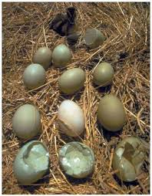
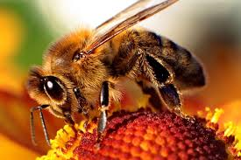
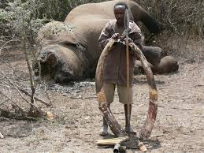
Human Actions https://www.youtube.com/watch?v=W4F6lD2k0Ls https://www.youtube.com/watch?v=12FnSRaIC8U

Slide 3
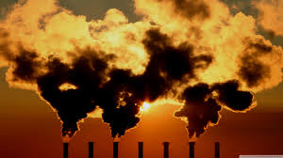
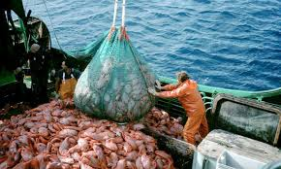
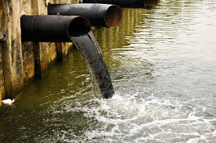
Human actions https://www.youtube.com/watch?v=5eTCZ9L834s

Slide 4
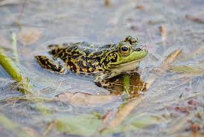
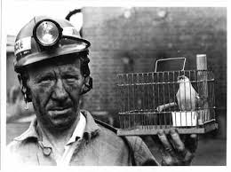
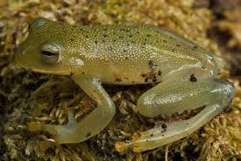
Indicator species

Slide 5
Disappearing Frogs
http://www.youtube.com/watch?v=NvP6j4Dj0VA

Slide 6
Climate Change
Bill Nye
http://www.upworthy.com/bill-nye-is-too-busy-saving-the-world-to-say-i-told-you-so?c=upw1

Slide 7
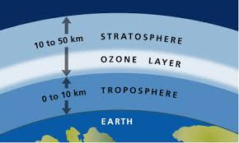
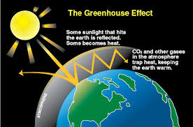
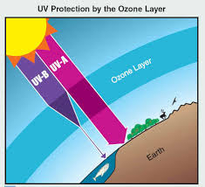
Green house vs ozone

