Slide 1
10.2 Reading Questions Answers

Slide 2
Cardiac Catheterization
1. List 3 external symptoms that help to detect coronary artery blockage.
Inability to sustain physical activity
Rapid breathing
General lack of energy

Slide 3
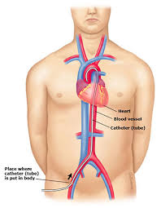
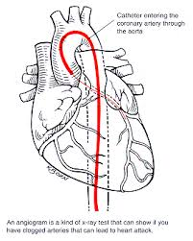
2. Explain (in your own words) what cardiac catheterization is.
A small tube called a catheter is inserted into an artery in the groin and passed up to the aorta and heart. X-ray dye is then used to spot blockages

Slide 4
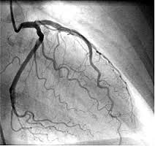
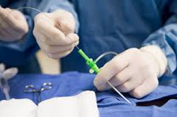
Cardiac Catheterization
X-ray dye showing coronary arteries blood flow
Inserting catheter

Slide 5
Setting the Heart’s Tempo
3. How is cardiac muscle similar/different to skeletal muscle? Why is this difference so important?
Similar – striated
Different – heart muscle can contract without being stimulated by external nerves (myogenic muscle)

Slide 6
4. What sets the heart’s beat or tempo? How does it work?
- The SA node acts as a pace maker, setting a rhythm of about 70 beats per minute and stimulates the atria to contract. The electrical signal travels to a second node, the AV node which acts as a conductor, passing nerve impulses through 2 large nerve fibers called Purkinji Fibers, through the septum toward the ventricles.

Slide 7
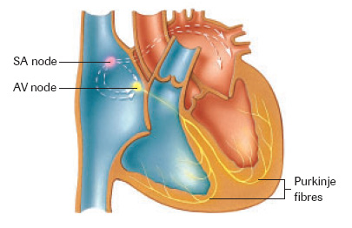
Label diagram

Slide 8
5. What is the role of sympathetic and parasympathetic nerves?
Sympathetic nerves – stimulated during times of stress, increase heart rate
Parasympathetic nerves – return the heart rate to normal resting levels following adjustments to stress.

Slide 9
6. What makes the lubb-dub heart sounds?
The closing of the heart valves
7. Explain diastole and systole.
Diastole – the relaxation of the ventricles
Systole – the contraction of the ventricles

Slide 10
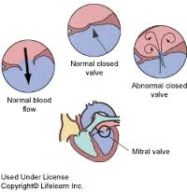
8. What is one cause of a heart murmur?
- When blood leaks past the closed valve because of an improper seal.

