Slide 1
10.3 Regulation of blood flow pgs. 328-334
Unit D
Biology 20
M.Caine

Slide 2
Cardiac Output
Cardiac Output is defined as the amount of blood that flows from the heart per minute.
It is calculated by the following:
Stroke volume (mL) X Heart rate (beats/min)
Stroke volume is the quantity of blood pumped with each beat of the heart. The stronger the heart contraction the greater the volume.
Question: What could increase the heart contraction?

Slide 3
Cardiac Output
Calculation:
Tammy has a stroke volume of 80mL/beat and a heart rate of 80 beats/min. What is her cardiac output?
80mL/beat x 80 beats/min = 6400mL or 6.4L/min
If Tammy’s cardiac output changes to 5600mL/min and her stroke volume remains unchanged, what is her new heart rate?
5600mL/min / 80mL/beat = 70 beats/min

Slide 4
Questions
How would the size of the individual affect their cardiac output?
Smaller individuals require less blood and have a lower cardiac output
Why do athletes often have lower heart rates?
Strong hearts can pump greater volumes of blood
with each beat

Slide 5
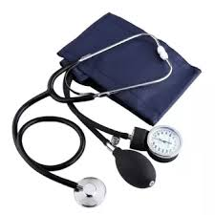
Blood Pressure
The device that is used to measure blood pressure is called a sphygmomanometer.
This device measures the systolic pressure (the pressure exerted by the ventricles when they contract) and the diastolic pressure (the pressure of the ventricles when they relax)

Slide 6
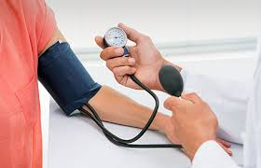
What do I listen for?
Once the cuff has been inflated, all blood flow to the lower arm is stopped, the valve is then released to allow blood to push past the cuff and when we hear the first heart beat, this is the systolic number.
When I no longer hear the heart beat, this is the diastolic number.
Example: 120 (systolic)
80 (diastolic)

Slide 7
Question
What are two factors that affect blood pressure that are normal changes?
Increase in cardiac output – exercise, activity
Decrease in cardiac output – sleeping, laying down

Slide 8
Question
What can cause an increase in blood pressure that could indicate a health problem?
A blockage in an artery. Decreased elasticity of the blood vessels – hardening of the arteries

Slide 9
Arteriole resistance – the diameter of the arteriole is constricted due to a blockage which reduces blood flow through the arteriole. This can lead to stroke, weakening of the arteries, weakening of the heart.

Slide 10
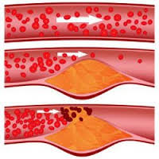
Artery blockage

Slide 11
Question
How does hypertension affect the circulatory system?
Blood vessels are often weakened and may rupture
The Body will compensate for weakened vessels by increasing support by adding more connective tissue
This causes the arteries to become hard and less elastic

Slide 12
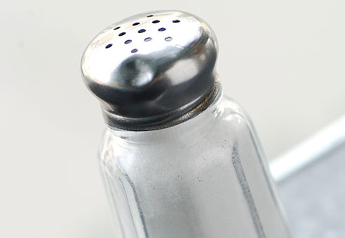
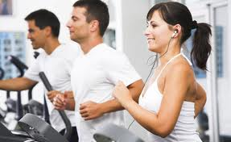
Question
What causes hypertension? What are two things anyone can do to avoid developing this condition?
Hypertension can be hereditary
Often caused by lifestyle (diet, activity level, smoking)
Salt in the diet is a prime cause

Slide 13
Problems when Blood Pressure is not Regulated
Low blood pressure reduces your capacity to transport blood especially to the tissues of the brain. This is why if your blood pressure is low, when you stand up quickly, you may feel dizzy. When blood pressure is low, the heart usually beats more quickly.
High blood pressure can weaken the artery walls and can lead to ruptures (stroke)

Slide 14
How does your body correct for high blood pressure?
Receptors located in the aorta and the carotid arteries send nerve impulses to the medulla oblongata. Messages are then sent to the sympathetic nerves and the parasympathetic nerves to dilate blood vessels and decrease cardiac output

Slide 15
How does your body correct for low blood pressure?
Sympathetic nerve impulses send messages to the blood vessels to constrict and causes an increase in cardiac output.
This occurs when there is significant blood loss with an injury

Slide 16
Blood Pressure Tutorial
http://www.youtube.com/watch?v=t0IngUYN2OA

Slide 17
What is thermoregulation and why is it important to our bodies?
Thermoregulation maintains a body temperature within a range that enables our cells to function efficiently
It protects the body from excessive heat (sending signals from the hypothalamus to the vessels to dilate to increase blood flow to the skin and to the sweat glands to initiate sweating causing cooling)

Slide 18
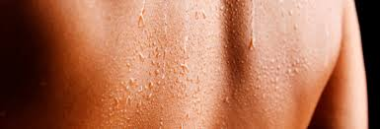
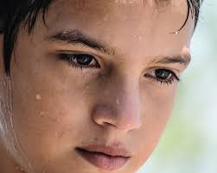
Sweating!

Slide 19
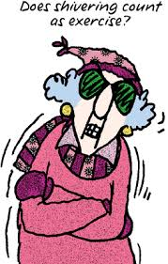
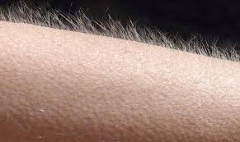
It also protects the body from excessive cold (sending signals from the hypothalamus to the vessels to constrict to reduce blood flow to the skin reducing heat loss as well to the muscles to contract – shivering to generate heat)

