Slide 1
Chapter 10.4
Capillary Fluid Exchange

Slide 2
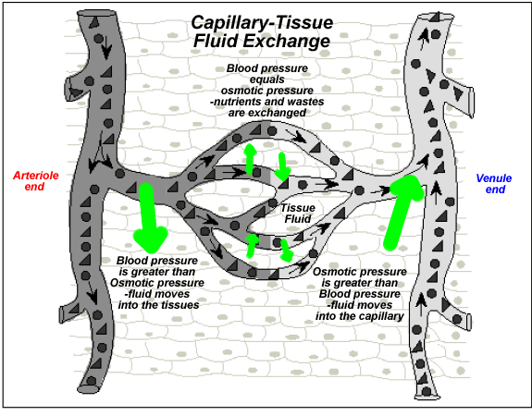
Capillary Fluid Exchange
Capillaries provide cells with oxygen, glucose and amino acids and are associated with fluid exchange between the blood and surrounding extracellular fluid (ECF).

Slide 3
Most fluids, oxygen and carbon dioxide diffuse through capillaries.
Water and certain ions pass through spaces between cells of capillaries.
Larger molecules and some proteins are exchanged by endocytosis or exocytosis.

Slide 4
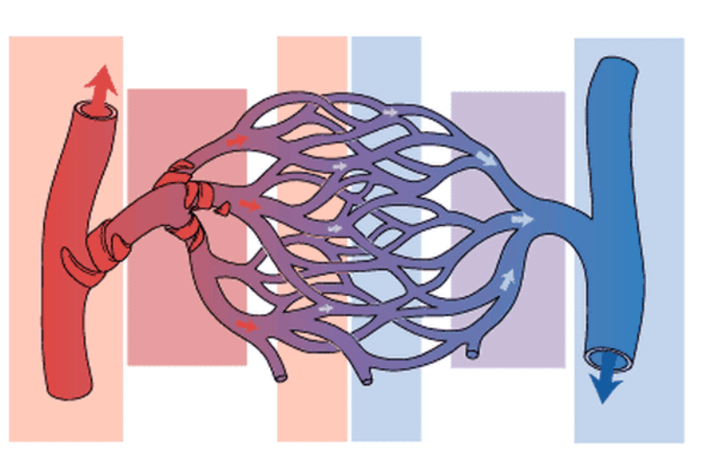
Arteriolar end –
Water moves out
Venous end – Water moves in
Arteriole
Venule
Fluid pressure –
35 mmHg
Fluid pressure –
15 mmHg
Osmotic pressure – 25 mmHg

Slide 5
Fluid pressure and osmotic pressure regulate water between the blood and ECF.
Water moves from an area of high pressure to an area of low pressure.
The outward flow of water and small mineral ions is known as filtration.
Capillaries are selectively permeable so proteins, red blood cells and white blood cells remain in the capillaries.

Slide 6
Fluid in and out of the capillaries must be balanced.
Large proteins are found in the blood and not in the ECF.
Osmotic pressure draws water back into the capillaries.
The proteins in blood and dissolved minerals are responsible for the movement of fluids into the capillaries.

Slide 7
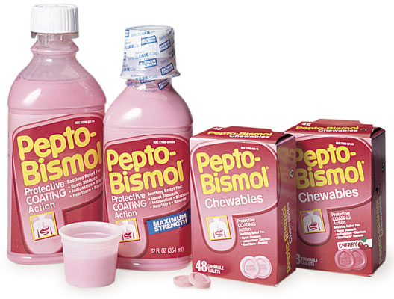
Movement of fluid into capillaries is called absorption.
Concentration of solutes in the blood can change due to fluid intake and excess fluid loss through perspiration, vomiting or diarrhea.

Slide 8
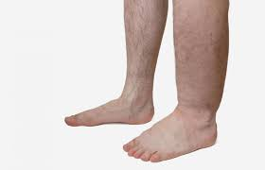
Lymphatic System
Slow leakage of proteins from capillaries into the ECF accumulate and cause osmotic pressure to decrease leaving water behind and tissues would swell (edema).
Water and proteins are drained from the ECF and returned to the circulatory system by way of another network of vessels: the lymphatic system.

Slide 9
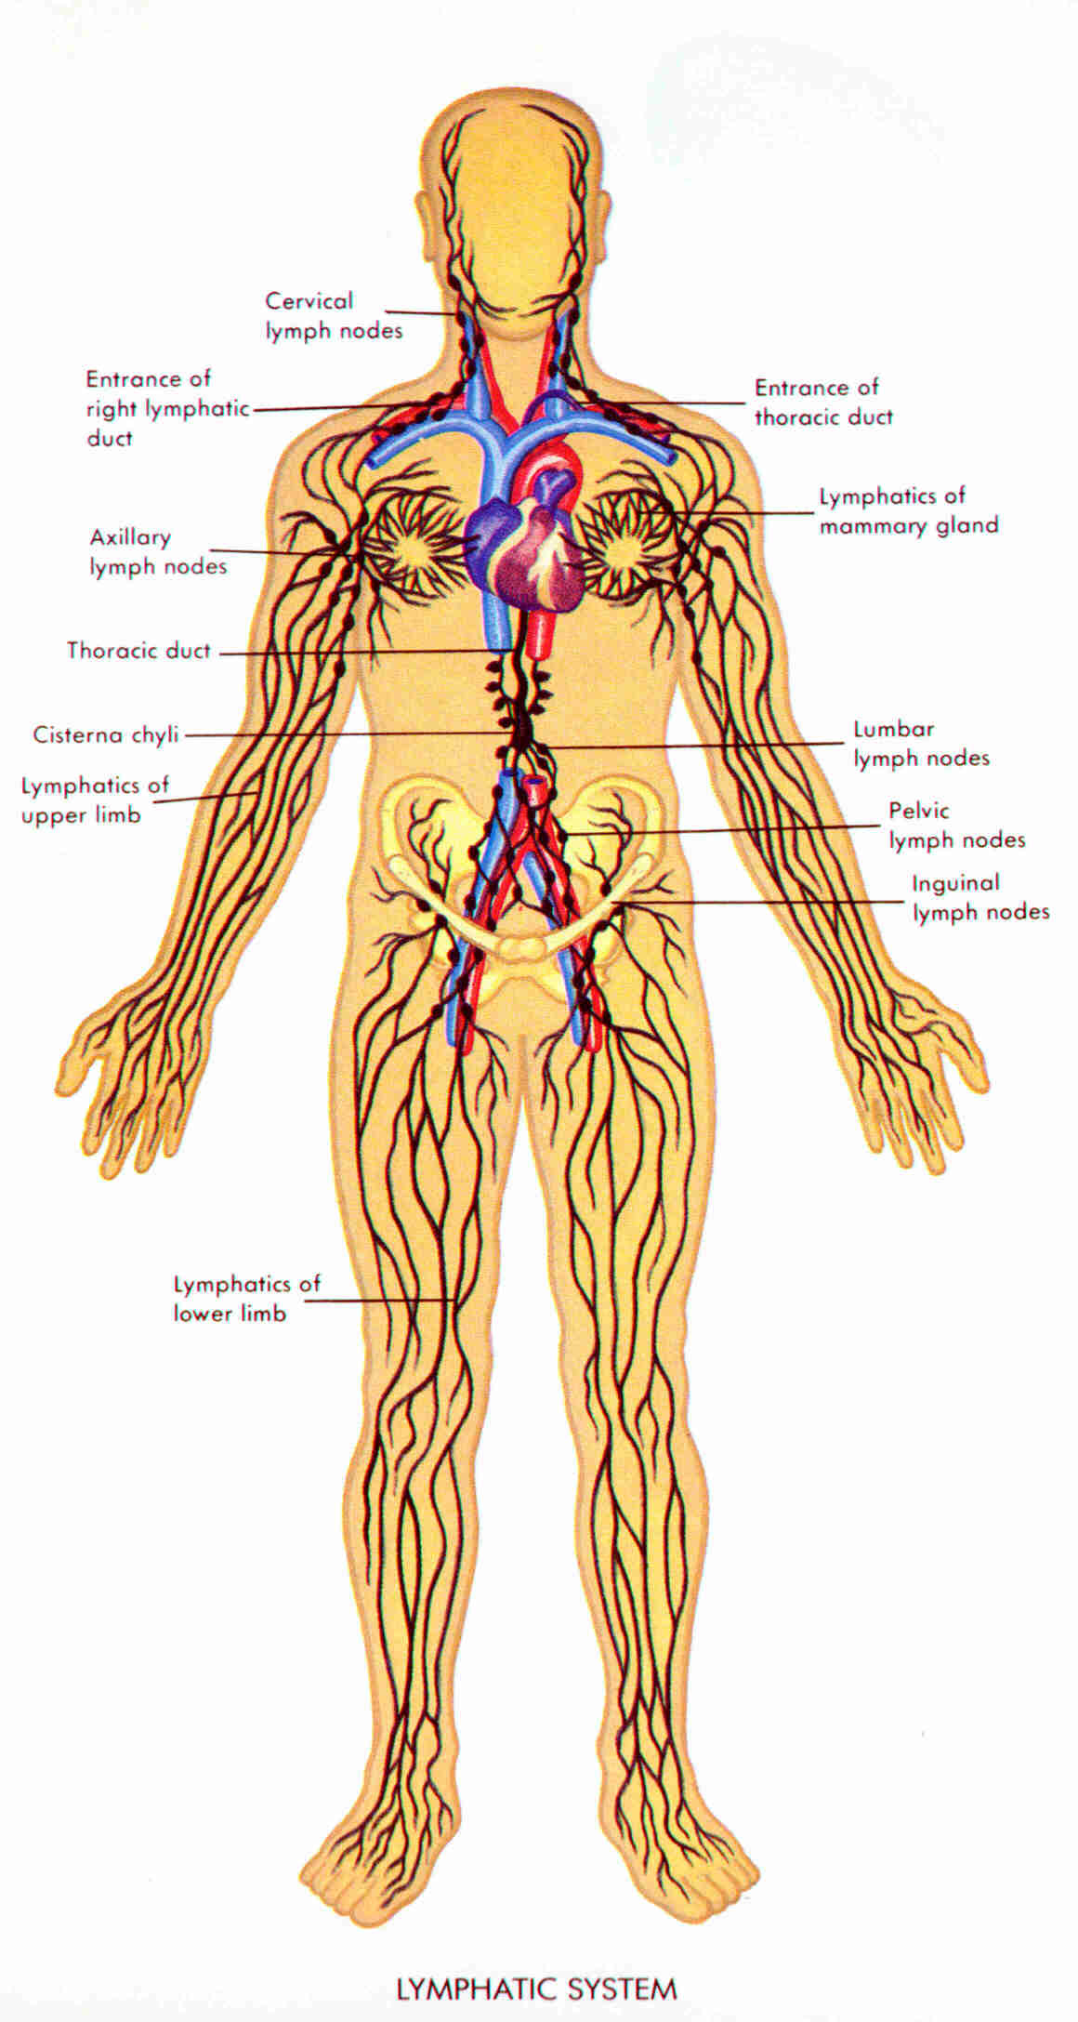

Slide 10
Lymph – a fluid similar to blood plasma is transported in open-ended lymph vessels that are similar to veins.
Operates by slow muscle contractions against the vessels, which are supplied with flap-like valves that prevent the backflow of fluids.
Lymph is returned to the venous system via the right and left subclavian veins.

Slide 11
Lymph Nodes – a mass of tissue that stores lymphocytes and removes bacteria and foreign particles from lymph (through phagocytosis). Found at intervals along lymph vessels.
Lymphocyte – a white blood cell that produces antibodies.
When your throat is sore, your lymph nodes sometimes swell in your neck.

Slide 12
Lymphoid Organs
Red Bone Marrow – where all types of blood cells are produced.
Stem Cells (found in marrow) – divide at incredible rates and differentiate into different types of white blood cells.
In children red bone marrow is found in most bones; where as in adults it is found primarily in the cranium, sternum, ribs, spinal column, and the long bones of the arms and legs – responsible for blood cell production.

Slide 13
Spleen – largest lymphoid organs. Upper left side of the abdominal cavity, just below the diaphragm. It is an excellent blood reservoir.
The spleen releases red blood cells in response to low blood pressure or when oxygen levels drop dramatically. Also helps purify blood.

Slide 14
Thymus gland – gets smaller with age. Front of trachea, just above the heart.
Where T lymphocytes (or T-cells) mature.
T-cells help ensure that they will not initiate an immune response against the bodies own proteins.

Slide 15
Review Questions
Answers:
The body would respond to blood loss by absorbing fluid from the ECF to help bring up blood pressure. (Absorption)
Lymph vessels are a series of open ended vessels that transport lymph fluid around the body.
Lymph is a fluid similar to plasma. It is carried by lymph vessels and is eventually returned to the circulatory system.
4. The spleen is important because it is an excellent blood reservoir.
The spleen releases red blood cells in response to low blood pressure or when oxygen levels drop dramatically. Also helps purify blood

