Slide 1
10.4 Capillary Fluid exchange
Textbook questions pg. 339

Slide 2
1. What two factors regulate the exchange of fluid between capillaries and the ECF?
A: Fluid pressure: water moves from an area of high fluid pressure in the capillaries to an area of low fluid pressure in the ECF. (Filtration)
Osmotic pressure: Proteins and dissolved minerals in the blood cause fluid from the ECF to move back into the blood by osmosis. (Absorption)

Slide 3
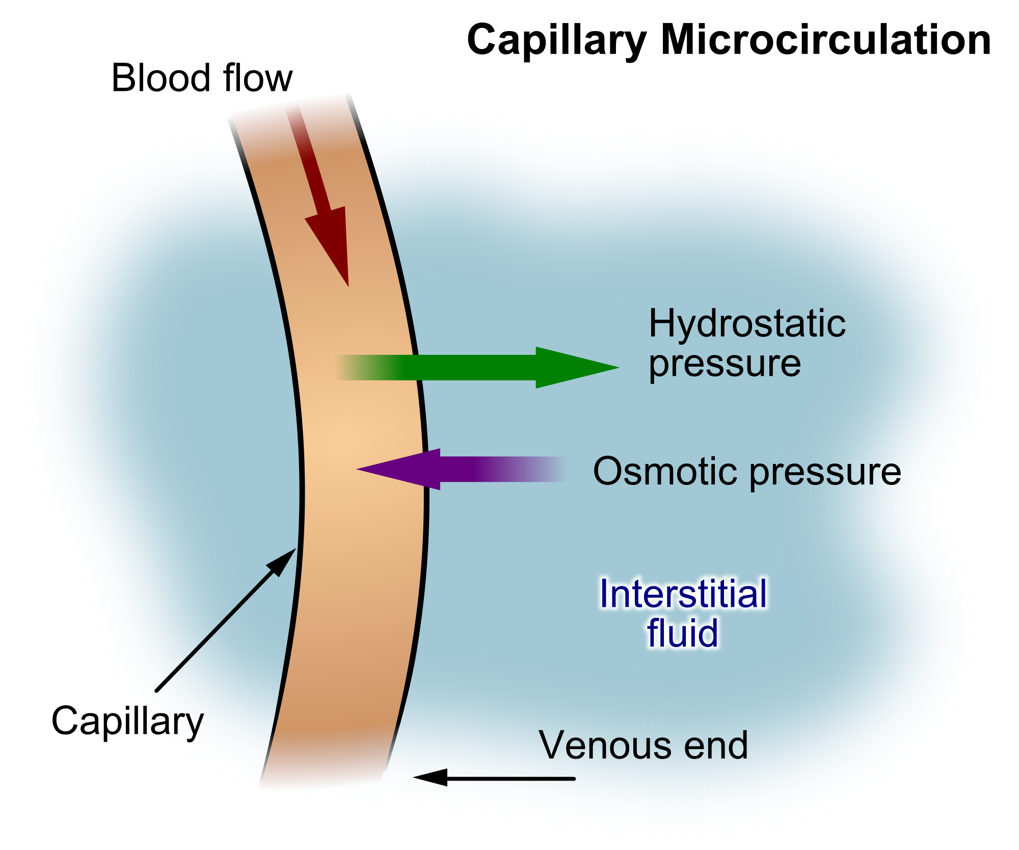
Fluid Pressure and osmotic pressure

Slide 4
2. Use the capillary exchange model to explain how the body maintains equilibrium following a hemorrhage (severe bleed)
A. Due to the loss of blood volume during hemorrhage (severe bleeding) the osmotic balance would have higher volume outside the capillaries than in so water moves into the capillaries to restore fluid volumes. (absorption)

Slide 5
3. Why does low concentration of plasma protein cause edema (fluid build up in tissue)?
A. When blood proteins are low such as in starvation, there are less solutes in the blood than normal which prevents the normal return of fluids back to the blood (decreased absorption) so more fluid remains in the tissues and ECF.

Slide 6
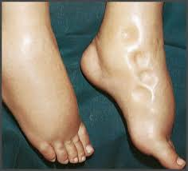
Edema

Slide 7
4. What are lymph vessels and how are they related to the circulatory system?
5. What is lymph? How is lymph transported? Where does it eventually go?
Lymph vessels are a system of open-ended vessels that collect proteins and debris from the ECF.
Lymph vessels are similar to veins – they rely on skeletal muscles to move the lymph and have valves to prevent back flow.
A. The lymph fluid is similar to blood plasma and lymph is eventually returned back to the circulatory system near the heart.

Slide 8
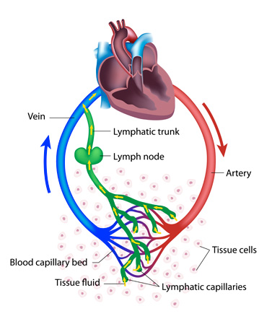
Lymphatic Vessels

Slide 9
6. Why are lymphocytes important to the immune system?
A. They are white blood cells that are involved in the production of antibodies.

Slide 10
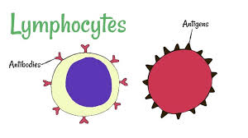
Lymphocytes

Slide 11
7. What is the importance of the spleen?
A. The spleen is the largest lymphoid organ and acts as a reservoir for blood and a filtering site for lymph.

Slide 12
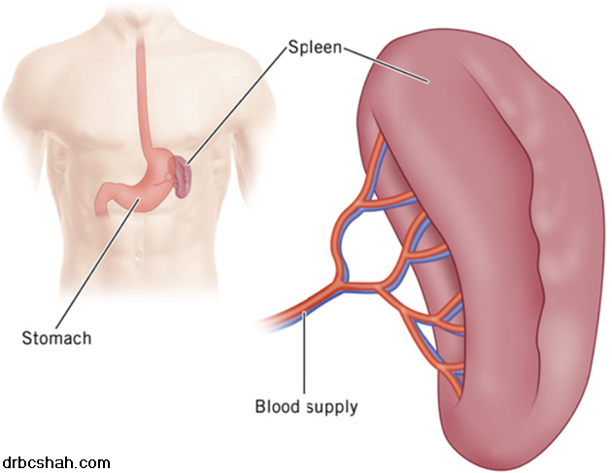
spleen

