Slide 1
Blood and Immunity Chapter 11.1

Slide 2
Blood
Although blood appears to be a thick, homogenous solution, the microscope reveals that it has both cellular and liquid components
Blood is a specialized type of connective tissue in which living blood cells are suspended in a non living matrix called plasma

Slide 3
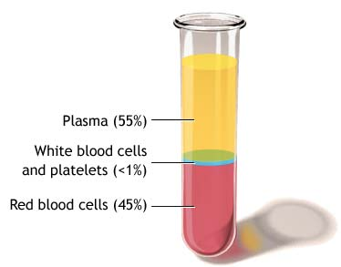
Components of Blood
Blood is broken into 3 main components
55% fluid called plasma (it is approximately 90% water, 10% blood proteins (albumins, globulins, fibrinogens), glucose, vitamins, minerals, dissolved gases, and waste products
less than 1% white blood cells
45% red blood cells

Slide 4
Plasma Proteins
Your plasma also contains three important proteins
Albumins- controls osmotic balance
Globulins - makes antibodies for protection
Fibrinogen - control blood clotting

Slide 5
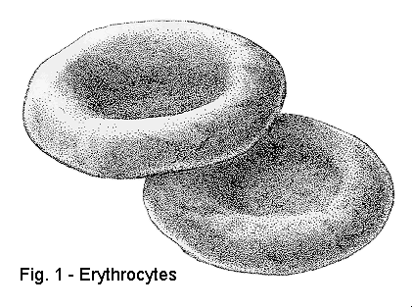
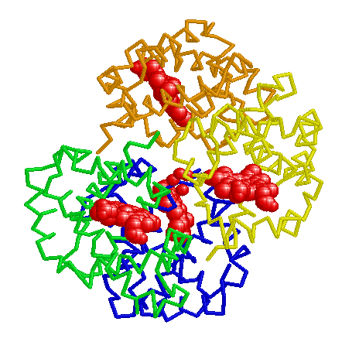
Erythrocytes
Erythrocytes (red blood cells) are small, round biconcave cells whose primary function is the transportation of oxygen.
Erythrocytes have iron containing pigments called hemoglobin which increases the capacity of blood to carry oxygen

Slide 6
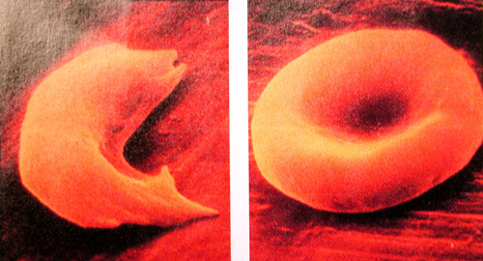
Erythrocytes are also enucleated (they have no nucleus) and as a result do not have to carry out cellular functions
Erythrocytes are replaced by the bone marrow approximately every 120-130 days

Slide 7
Leucocytes White Blood Cells
White Blood Cells (WBC) are defenders against bacteria, viruses, and foreign substances of any kind. They are killed to make pus
New white blood cells are formed in the bone marrow

Slide 8
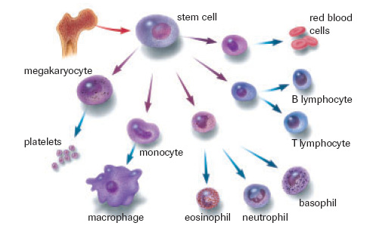
WBC’s
There are five main types of white blood cells
neutrophils- general granulocyte
monocytes- make macrophages to engulf invaders
esinophils- granulocyte which kills parasites
basophils- granulocyte which releases histamines
lymphocytes- make B and T cells
ALL HELP IN THE FIGHT AGAINST DISEASE

Slide 9
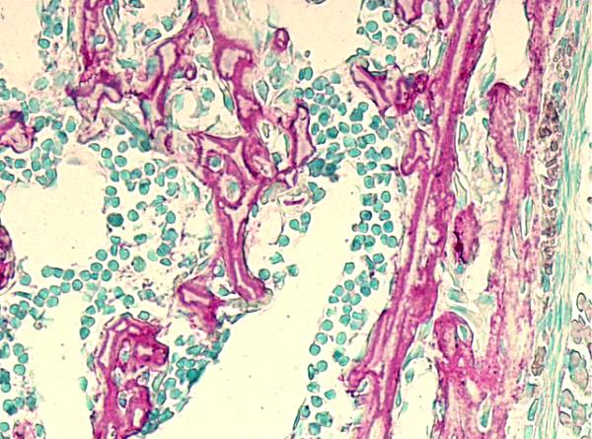
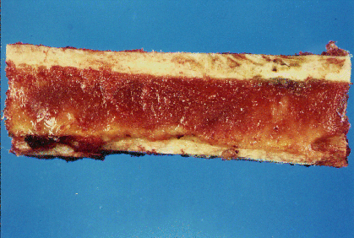
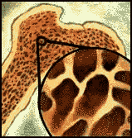
BONE MARROW

Slide 10
Platelets
Platelets are cytoplasmic fragments that break off from unusually large cells found in the bone marrow
They play an essential role in the clotting of blood and in plugging breaks in blood vessels

Slide 11
Textbook questions
Do #1-6 on page 352

Slide 12
The Functions of Blood
Blood is the most abundant fluid in our bodies. It does a number of jobs to keep us healthy and strong including distribution of substances throughout our bodies, regulation of blood levels and body protection

Slide 13
Distribution
Delivering oxygen from the lungs and nutrients from the digestive tract to all body cells
Transporting metabolic waste products from cells to elimination sites
Transporting hormones from the endocrine organs to their target organs

Slide 14
Regulation
Maintain appropriate body temperature by vasoconstriction and vasodilatation
Maintain normal pH in body tissues
blood proteins act as buffers
reservoir of bicarbonate ions
Maintain adequate fluid volume in the circulatory system
salts and blood proteins prevent excess fluid loss

Slide 15
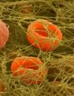
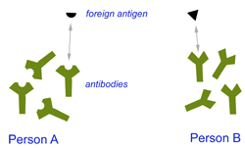
PROTECTION
1. protects our bodies against excessive blood loss (clotting and spasms)
2. protection against foreign invaders through the lines of defense of the immune systems white blood cells (WBC) and antibodies

Slide 16
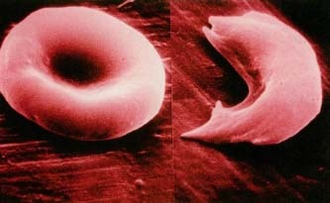
Blood Disorders
Anemia- A condition where the blood has an abnormally low oxygen carrying ability
Causes include
insufficient # RBC
decreased hemoglobin (no iron→ hemoglobin→ RBC)
abnormal hemoglobin (ie: Sickle cell anemia)

Slide 17
Leukemia
Refers to a group of cancerous conditions of white blood cells which remain unspecialized and mitotic, and suppress or impair normal bone marrow functioning
WBC have developed too quickly and cannot carry out functions properly
They use resources needed by healthy cells

Slide 18
Hemophilia
do not have proper proteins for clotting
increased occurrence in males
simple injuries can be fatal, need to be treated with transfusion or clotting agents
many contracted AIDS when there were improper screening practices in place

Slide 19
Blood and Immunity
Clotting
Blood Types
Rh Factor

Slide 20
Blood Clotting
Blood clotting maintains homeostasis by preventing the loss of blood from torn or ruptured blood vessels. They also provide additional support to weakened blood vessels that have been injured so they do not rupture

Slide 21
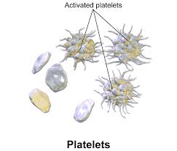
Blood Clotting
When you are injured often the vessel is torn and jagged. Platelets will catch on the jagged edges and rupture.
This initiates a series of events that end in the formation of fibrin.

Slide 22
Fibrin is very fine threads that will wrap around the damaged area, sticking to it and to each other sealing the skin with a clot.
This clot blocks microbes but allows WBC’s to gain access

Slide 23
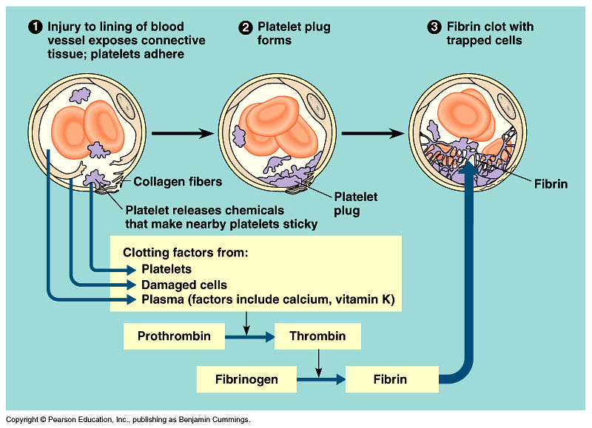

Slide 24
Problems with Clotting
Sometimes clots can seal blood vessels. This blockage, called a thrombus, will prevent local tissues from getting oxygen and nutrients
If a clot should dislodge it becomes an embolus. This may become lodged in vital organs
blockages in the brain (cerebral) will cause stroke
blockages in the heart (coronary) will cause heart attack

Slide 25
Blood Typing
Karl Landsteiner discovered the secret to transfusions. There are special markers (glycoproteins/antigens) found on the membrane of the red blood cells
The blood contains antibodies that recognize antigen surface markers on RBC’s

Slide 26
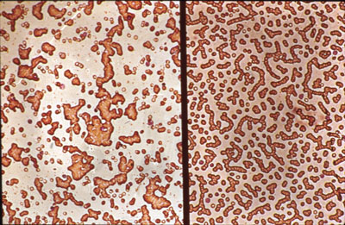
If two incompatible blood types are mixed during a transfusion, the antibodies cause the cells with the ‘wrong’ surface markers to clump together= agglutination

Slide 27
ABO Blood Typing
Type A blood has A markers and B antibodies
Type B blood has B markers and A antibodies
Type AB blood has A and B markers and no antibodies (universal recipient)
Type O blood has neither A or B markers but both A and B antibodies (universal donor)

Slide 28
ABO Blood Groups
 | Antigen | Antibody | Donate To | Receive From
A
B
AB
O

Slide 29
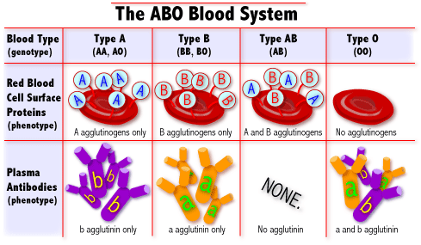
Antigens and Antibodies
Blood Type
Type A
Type B
Type AB
Type O
Red Blood Cell Surface Antigens
Plasma Antibodies

Slide 30
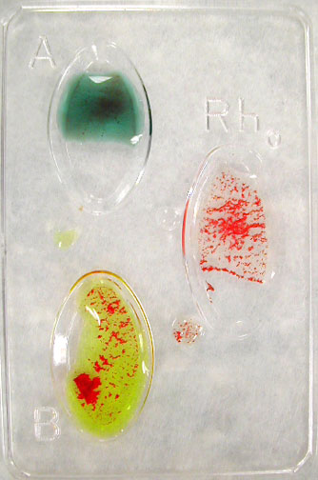
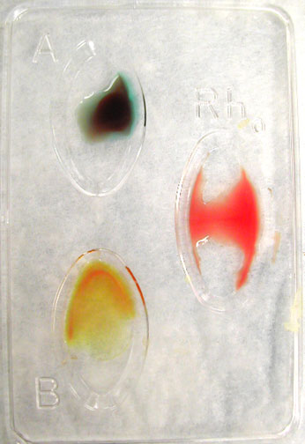
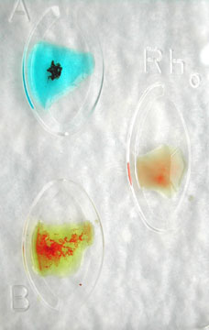
Agglutination Response

Slide 31
Blood Type Frequencies
Blood types in Canada | %
A | 42
O | 46
B | 9
AB | 3

Slide 32
Rh Factor
Just as there are different major blood groups, such as type A and type B, there also is an Rh factor. The Rh factor is a protein that can be present on the surface of red blood cells. Most people have the Rh factor—they are Rh positive. Others do not have the Rh factor—they are Rh negative
If you are Rh+, your blood cells have the Rh marker and you DO NOT MAKE antibodies against yourself
If you are Rh-, your immune system will treat the Rh marker as foreign and produce Rh antibodies

Slide 33
Rh Pregnancy Problems
When an Rh-negative mother’s blood comes into contact with blood from her Rh-positive fetus, it causes the Rh-negative mother to make antibodies against the Rh factor. These antibodies attack the Rh factor as if it were a harmful substance. A person with Rh-negative blood who makes Rh antibodies is called "Rh sensitized."

Slide 34
Problems during pregnancy can occur when Rh antibodies from an Rh-sensitized woman cross the placenta and attack the blood of an Rh-positive fetus. The Rh antibodies destroy some of the fetal red blood cells. This causes hemolytic anemia, where red blood cells are destroyed faster than the body can replace them.
Red blood cells carry oxygen to all parts of the body. Without enough red blood cells, the fetus will not get enough oxygen. Hemolytic anemia can lead to serious illness. Severe hemolytic anemia may even be fatal to the fetus.

Slide 35
Treatment
If you are Rh negative, you will be given a shot of Rh immunoglobulin (RhIg). RhIg is made from donated blood. When given to a nonsensitized Rh-negative person, it targets any Rh-positive cells in the bloodstream and prevents the production of Rh antibodies. When given to an Rh-negative woman who has not yet made antibodies against the Rh factor, RhIg can prevent fetal hemolytic anemia in a later pregnancy.

Slide 36
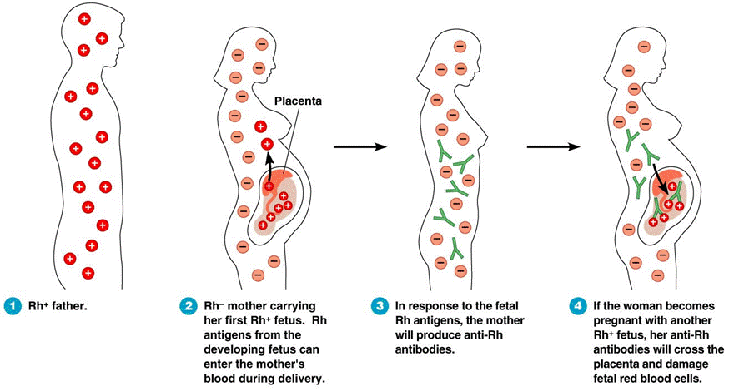
Rh Factor During Pregancy

Slide 37
Textbook Questions
Do questions #7-9 and 15-18 pg. 356

