Slide 1
12 Cranial Nerves
HCS 2050
Nervous System and Senses
SLO: 1.8.8 - Name and locate the 12 cranial nerves

Slide 2
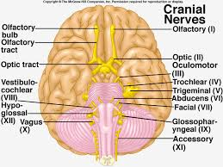

Slide 3
Cranial Nerves
There are 12 pairs of cranial nerves.
They are numbered, usually in Roman numerals, according to their connection to the brain, beginning anteriorly (front) and proceeding posteriorly (back)

Slide 4
Functionally we can think of cranial nerve messages as belonging to one of four categories
Special sensory impulses – smell, taste, vision, and hearing located in special sense organs in the head
General sensory impulses – pain, touch, temperature, deep muscle sense, pressure and vibration. Impulses come from receptors widely distributed throughout the body

Slide 5
Somatic motor impulses – resulting in voluntary control of skeletal muscles
Visceral motor impulses – producing involuntary control of glands and involuntary muscles (cardiac and smooth muscle)
*Part of the autonomic nervous system

Slide 6
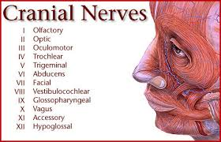

Slide 7
Practice!
Do workbook pg. 175 using your textbook pg. 230

