Slide 1
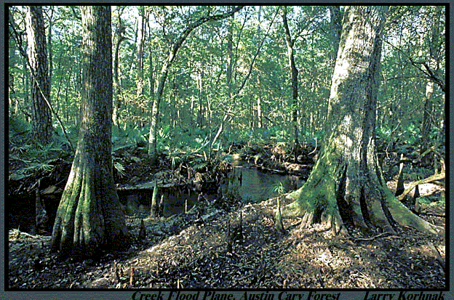
4.1 – Interactions within Ecosystems
Pages 86-93

Slide 2
Ecosystems:
Include the community of living things and its physical environment.
In looking at a forest ecosystem, an ecologist could measure how much sunlight (abiotic) reaches the forest floor, and how the amount of sunlight affects the plants and animals (biotic) that live in the ecosystem

Slide 3
Ecotones and Biodiversity
Ecotones – transition areas that contain species from bordering ecosystems.
Ecosystems rarely have sharp boundaries and organisms can move back and forth between ecosystems
This offers greater biodiversity because there are more species than either single ecosystem

Slide 4
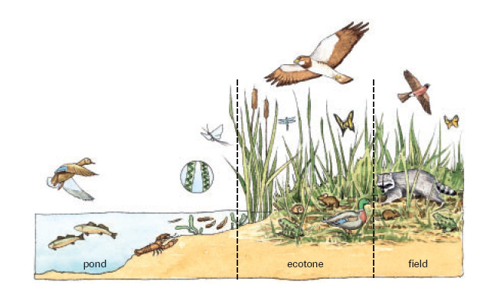

Slide 5
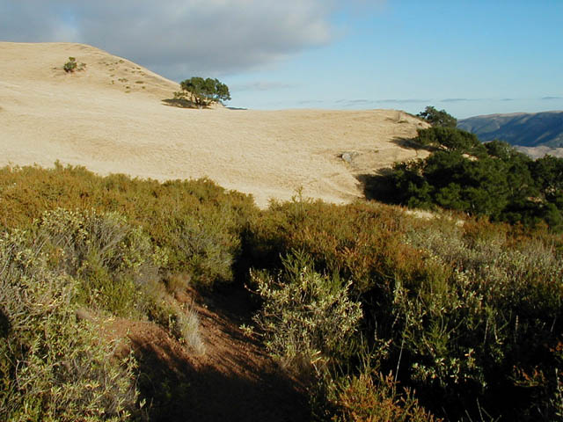
Ecotone

Slide 6
Roles in Ecosystems
Ecological Niche – an organism’s role in an ecosystem:
- its place in the food web
- its habitat
- its breeding area
- the time of day it is most active
* Everything an organism does to survive and reproduce

Slide 7
What is your niche?
What is your “role” in your ecosystem?
In your family?
On a team?
In a club or organization?
In our society?

Slide 8
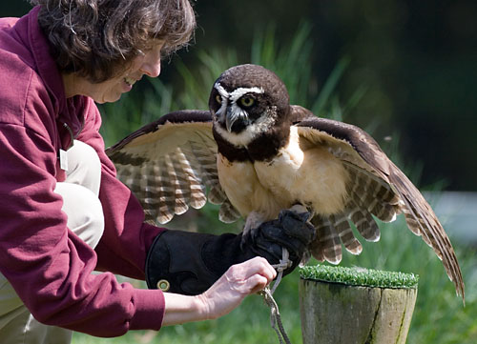
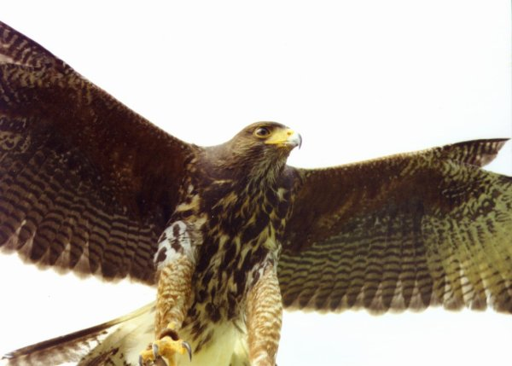
Owl and Hawk

Slide 9
Niches Continued . . .
Even though the owl and the hawk feed on many of the same organisms, they occupy distinctly different niches.
Owl:
- Short wings allow it to hunt in forests.
- Active during dusk and at night – excellent vision to sense movement, excellent hearing to hear prey
- Nest in the deep cover of trees

Slide 10
Hawks
- Long wings that are ideal for soaring above grassland
- Hunt during the day
- Vision is excellent to detect changes in color patterns – easier to see prey that are hidden by their camouflage
- Nest near the tops of taller trees

Slide 11
The higher the number of different niches in an ecosystem, the more organisms that will be found.

Slide 12
Biodiversity
http://www.youtube.com/watch?v=275bxGiHrVM
https://www.youtube.com/watch?v=YLt0-yoOKvw

Slide 13
Competition for Niches
When a new species enters an ecosystem, it comes into competition for a niche with one or more of the species already in the ecosystem.
The new species is often called an “exotic species” because it is not native to the ecosystem.
Native species might not be able to compete successfully for space, food, or reproductive sites.

Slide 14
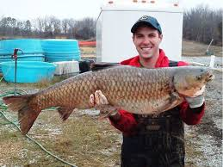
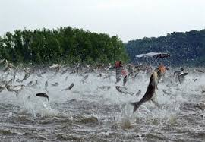
Asian Carp and Ragweed – Exotic Species
https://www.youtube.com/watch?v=rPeg1tbBt0A
https://www.youtube.com/watch?v=lnliU87xJnM

Slide 15
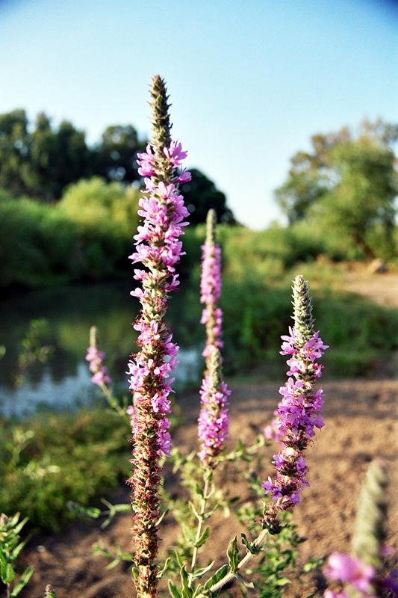
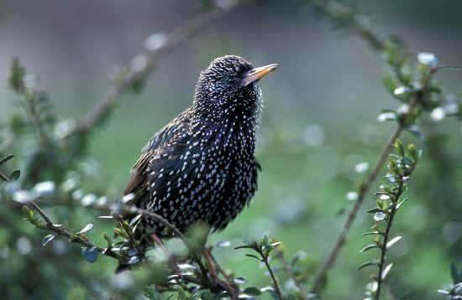
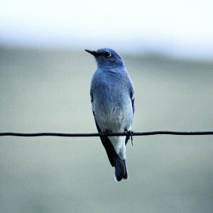
Competition for Niches (Examples)
Purple Loosestrife Starling
Mountain Bluebird

Slide 16
Student Workbook Questions
Complete 4.1 questions 1-3 – use your textbook and notes to help you.

