Slide 1
4.2 Terrestrial and Aquatic Ecosystems

Slide 2
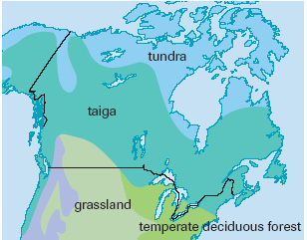

Slide 3
Name | Abiotic Factors | Biotic Representatives
Taiga (Boreal Forest) | Low sunlight on forest floor Soil is acidic (needles falling to the forest floor) Cooler temps 50-250 cm of precip. | Spruce and Pine trees Shrubs, ferns, mosses Bears, moose, deer, owls
Muskeg | Cold temps Short growing season Permafrost beneath soil Low precip. 50-150cm Very little decomposition – poor soil Very little vegetation | Rapidly flowering plants, mosses, lichen Bears, caribou, ptarmigans
Grassland | Good sunlight Warm temps Rich fertile soil Dry – 25-100cm of precip Too dry for trees | Grasses Bison, deer, rabbits, hawks, bison, grasshoppers
Deciduous Forest | Good sunlight Warm temps Best soil Good precip – 75-250cm | Deciduous (leafy trees), shrubs Bears, weasels, moose deer, woodpeckers

Slide 4
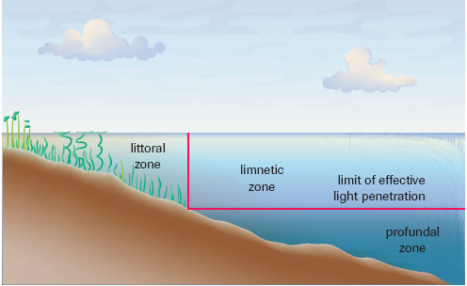
Aquatic Ecosystem - Zones of a Lake
Plankton (autotrophs and heterotrophs), fish, birds
Rooted plants, frogs,tadpoles, insects
Bottom feeding fish, bacteria, decomposers

Slide 5
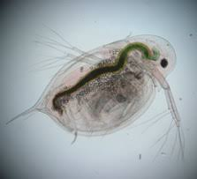
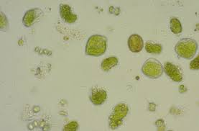
Plankton – Limnetic Zone
Phytoplankton - autotroph
Zooplankton - heterotroph

