Slide 1
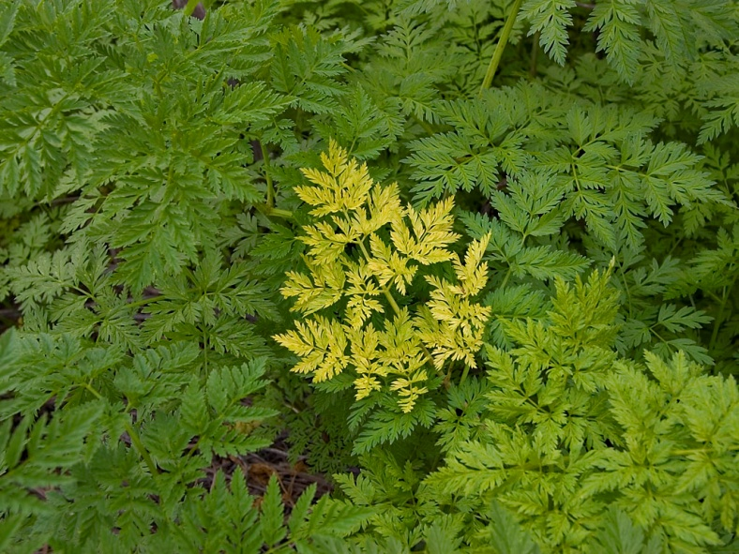
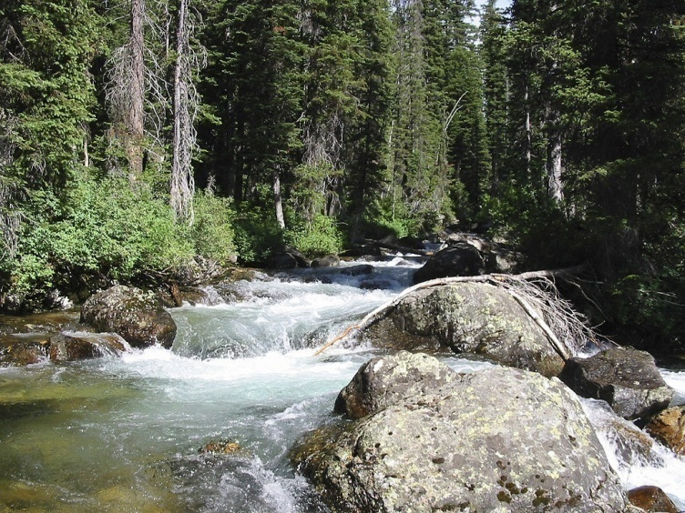
Factors Affecting Ecosystems
Chapter 4.3
Pgs. 101-107

Slide 2
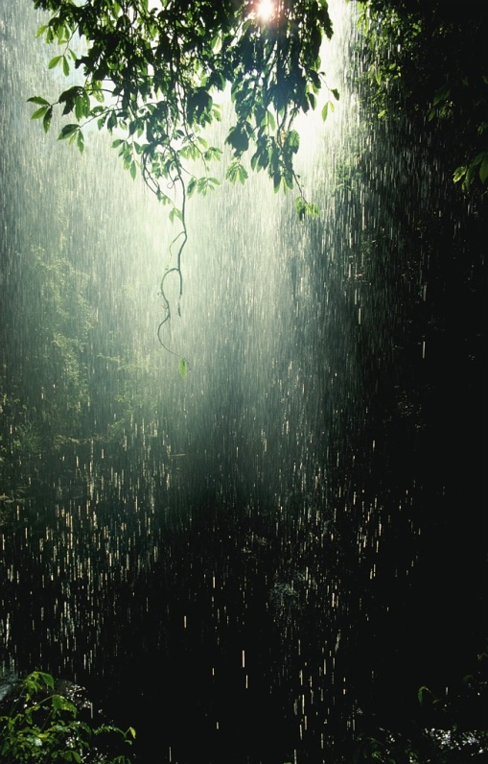
Factors Affecting Terrestrial Ecosystems: Abiotic Factors
Abiotic factors can limit the size of populations and can also determine the number of species that can survive in each ecosystem.

Slide 3
Soil
The thin layer of soil, rarely more than 2 meters thick, provides nutrients for all plants that grow on land.
The quality and amount of soil available are crucial factors in determining the size and health of the plant community and in turn, the biodiversity of an ecosystem.

Slide 4
https://www.youtube.com/watch?v=I6HGPoQ3dZY

Slide 6
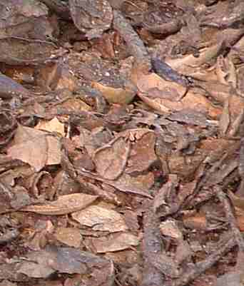
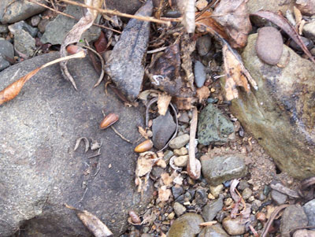
Layers of Soil
Litter – the upper layer of soil, composed mainly of partially decomposed leaves and grasses.
Acts like a blanket, insulating temperature and preventing water loss.

Slide 7
Topsoil – the soil layer beneath the litter, composed of small particles of rock mixed with humus.
Humus – decaying plant and animal matter
Humus is usually black , so topsoil is often black.
Topsoil usually contains a rich supply of minerals and other nutrients that plants require for growth (biogeochemical cycles)
Also present in the topsoil, in the spaces between the rock particles, are air and water. Oxygen is needed for decomposers to break down dead material

Slide 8
Humus

Slide 9
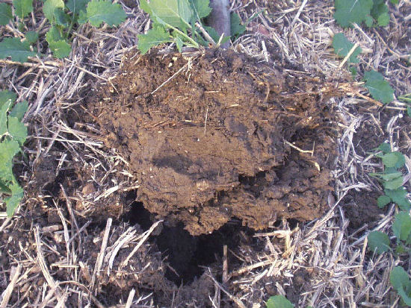
Topsoil

Slide 10
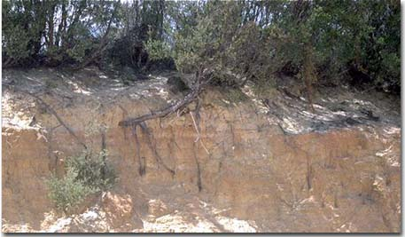
Subsoil – the soil layer beneath the topsoil, usually containing more rock particles and less organic matter than the topsoil
Usually lighter in color because of the lack of humus.
Can contain relatively large amounts of minerals such as iron, aluminum and phosphorus.

Slide 11
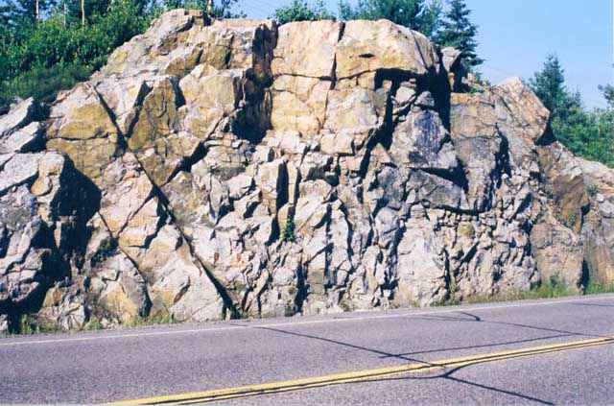
Bedrock – the layer beneath the soil, composed of rock
Bedrock marks the end of the soil
See figure 2 page 102

Slide 12
Soil: Acidic, Neutral or Basic
The pH of soil is determined by the nature of the rock from which it was formed, and by the nature of the plants that grow in it.
Humans contribute to higher levels of acidity in many soils by burning fossil fuels such as coal, oil and gasoline which release sulfur dioxide and nitrogen oxides into the air. These chemicals result in acidic rain and snow.
Basic soils are often referred to as alkaline soils.
The pH of the soil determines which plants will grow best.

Slide 13
A Look at Soil
http://multimedia.agr.gc.ca/22502/22502-4/22502-4-video-590x332-eng.mp4

Slide 14
Effects of Acid Rain

Slide 15
Water
The amount of available water in an ecosystem is another important abiotic factor.
This factor is part of the overall climate of the region.
All organisms depend on water to survive.
The amount of available water is determined by the amount and type of precipitation (rain, snow etc.)
The amount of available water is also affected by how long it stays in the upper layers of soil, and how much collects beneath the soil.

Slide 16
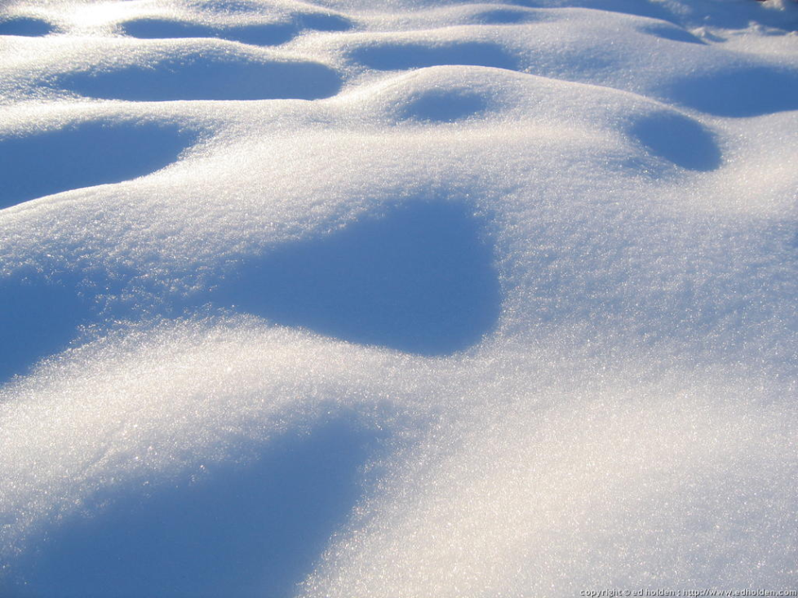
Water

Slide 17
Groundwater – water in the soil or rock below Earth’s surface
Water table – the boundary between the saturated layer and the unsaturated soil above where the water pools underground
The depth of the water table in an area affects the organisms that grow there.
Plants with long roots can draw water from the water table even though there is not a lot of precipitation

Slide 18
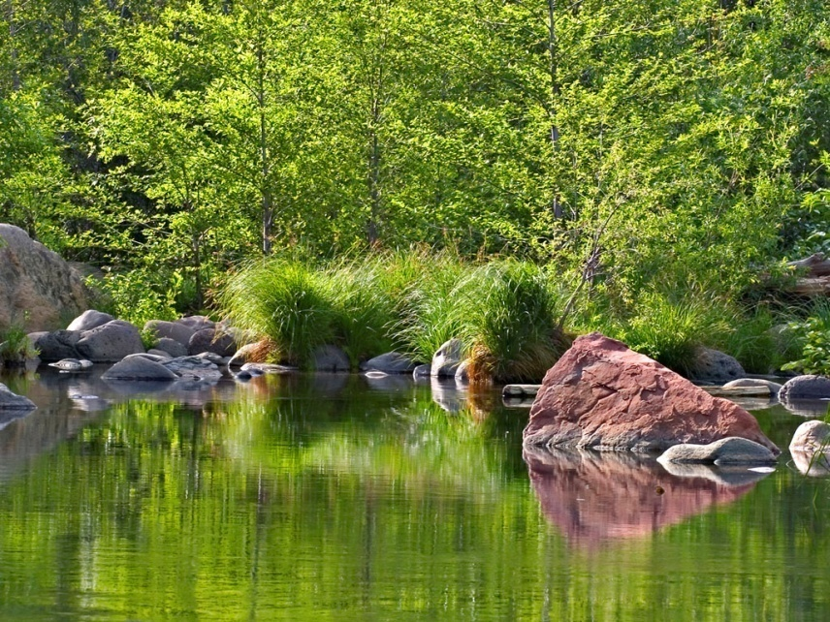
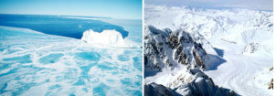
Temperature
Temperature, like available water, is part of the overall climate of a region
Temperature can vary significantly throughout the year in an ecosystem, which affects both biotic and abiotic factors.

Slide 19
Temperature: Adaptations
Conifers – keep their leaves (needles) throughout the winter, which allows them to survive short growing seasons
Grassland populations – grasses above the ground freezes off in the winter, the roots survive to regrow in the spring
Loons, ducks and some hawks – migrate to warmer climates
Black bears and some other mammals – hibernate (become inactive) during the winter

Slide 20
Sunlight
All terrestrial ecosystems are affected by the amount of sunlight they receive.
Ecosystems at the equator – sunlight is fairly constant
Ecosystems more north or south – experience changes in the amount of sunlight depending on the time of year
Ecosystems may also experience less sunlight if they are in shaded areas (forest floors, north sides of mountains)

