Slide 1
Factors Affecting Aquatic Ecosystems
4.3 Part 2
Pgs. 104 - 106

Slide 2
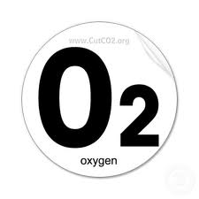
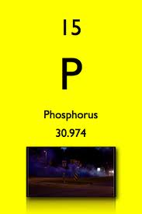
Chemical Environment
Salt vs. Fresh
Levels of oxygen
- Colder water can hold more dissolve O2
Dissolved naturally occurring minerals such as nitrogen, phosphorus and organic pollutants

Slide 3
Temperature
Based on seasons and depth of the body of water
Winter – ice covered
Deep lakes, oceans – little sunlight

Slide 4
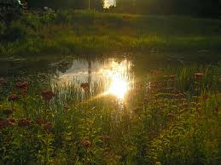
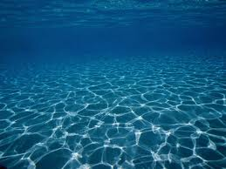
Sunlight
More sunlight in the upper levels
Warmer water
More photosynthetic organisms

Slide 5
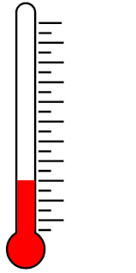
Seasonal Variations in Canadian Lakes
Water’s unique properties include that it is most dense at 4 degrees Celsius and becomes less dense as it cools below 4 degrees Celsius

Slide 6
Winter:
As a result in winter the water is arranged in layers based on density
Water near the surface is at or slightly above zero degrees Celsius
The densest water at four degrees Celsius is found at the bottom
Too little sunlight penetrating through ice and snow can decrease photosynthesis leading to very low levels of photosynthesis and lower levels of oxygen

Slide 7
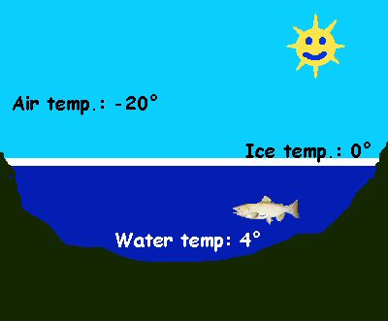
Winter

Slide 8
Spring and Fall Turn Over
The layers in the lake become mixed as temperatures cool or warm near four degrees
Spring and fall wind also cause waves that increase surface area as well as stirs the water
Both of these cause a mixing of oxygen into the lower levels of the lake

Slide 9
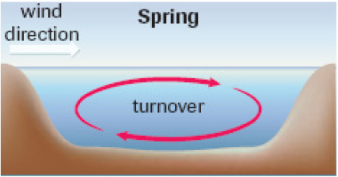
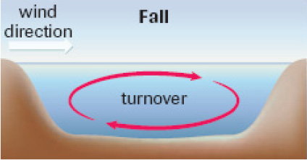
Spring and Fall Turnover

Slide 10
Turnover Video:
https://www.youtube.com/watch?v=p_k5T2wnPSg

Slide 11
Summer
Layers again form due to density
Little mixing occurs of oxygen from the surface to the depths
When water in the upper layers becomes warmer it loses it’s ability to hold dissolved oxygen

Slide 12
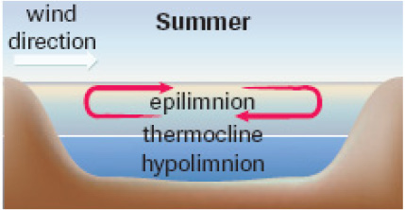
Summer

Slide 13
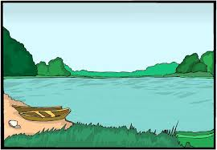
Practice Questions
Complete 4.3 questions in your Question Booklet

