Slide 1
Limits on population and communities in ecosystems
Chapter 4.4 – pages 108 - 111

Slide 2
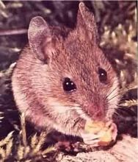
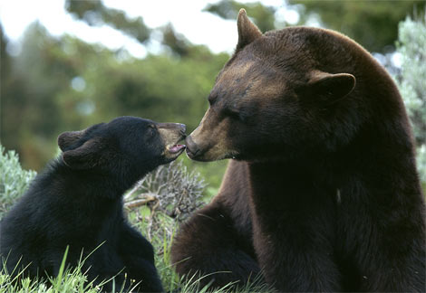
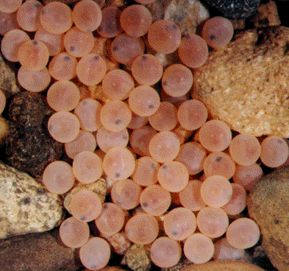
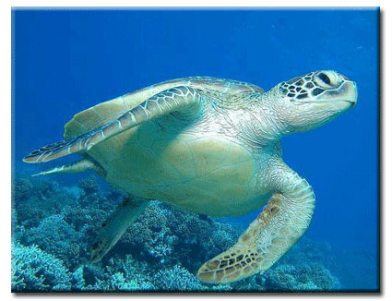
Biotic potential
Biotic potential – the maximum number of offspring that a species could produce with unlimited resources.

Slide 3
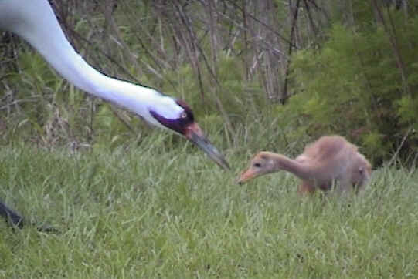
Factors affecting biotic potential
Birth potential – the maximum number of offspring per birth.
Example: Whooping crane only lays 2 eggs per year and usually only one survives.

Slide 4
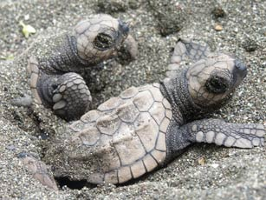
Capacity for Survival – the number of offspring that reach reproductive age.
Example: The female sea turtle lays many eggs, but only a few even reach the sea, and still fewer reach maturity.

Slide 5
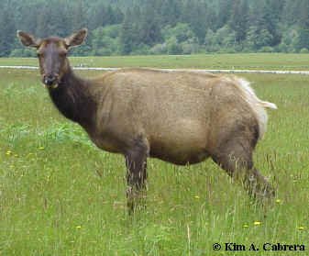
Breeding Frequency – The number of times that a species reproduces each year.
Example: Elk mate only once per year, during the fall.

Slide 6
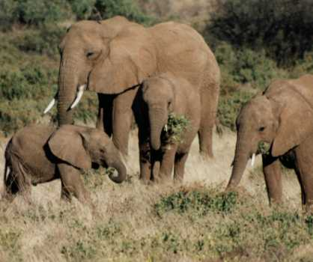
Length of Reproductive Life – the age of sexual maturity and the number of years the individual can reproduce
Example: African elephants reach sexual maturity at about 15 years of age, but may reproduce until they are 90!

Slide 7
Limiting factors
Any resource that is in short supply is a limiting factor on a population.
- food
- water
- territory
- presence of pollutants/toxic chemicals

Slide 8
Carrying capacity
Carrying capacity – the maximum number of individuals of a species that can be supported by an ecosystem.
The carrying capacity of any species is determined by the availability of resources, such as food and water
See field mouse example on page 109.

Slide 9
Limits of tolerance
Law of minimum – states that the nutrient in the least supply is the one that limits growth.
Law of tolerance – states that an organism can survive within a particular range of an abiotic factor.
The greater the range of tolerance, the greater the organisms ability to survive.

Slide 10
Density-independent and density-dependent factors
Density-independent factor – a factor in an ecosystem that affects members of a population regardless of population density
Example: fire or flood are two naturally occurring events and will affect a population regardless of its size

Slide 11
Density-dependent factor – a factor in an ecosystem that affects members of a population because of population density
Examples: Food supply, water quality, sunlight, disease and territory will affect populations because of the density of the population
See table on page 111
* Answer question 2 on pg. 111

Slide 12
Limiting Factors Video
https://www.youtube.com/watch?v=pPw51fDTl68

