Slide 1
4.5 Changes in Ecosystems pgs. 113 - 121

Slide 2
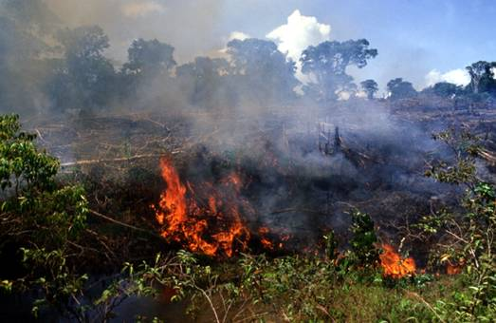
Deforestation
Slash and Burn – the complete clearing of a forest by felling and burning the trees

Slide 3
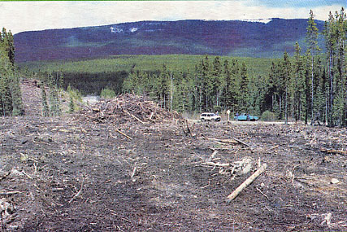
Deforestation
Clear cutting – the removal of all trees in an area

Slide 4
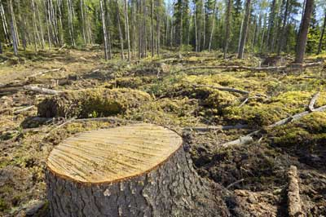
Deforestation
Selective cutting – the harvesting of only certain trees from an area

Slide 5
Negative Effects
Soil erosion and runoff into streams increases
Nitrates and other nutrients are carried into streams and ponds, increasing algae growth
Loss of habitat
Replanting can take 80-90 years before trees are large enough to harvest
More details can be found on pg 114

Slide 6
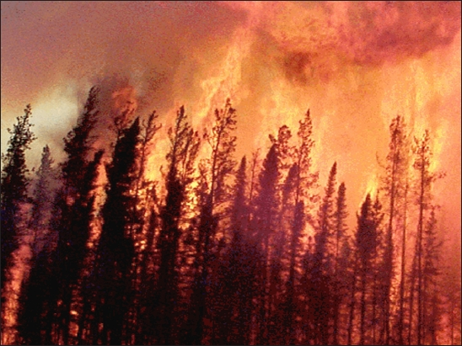
Fire
Fire is an important and often helpful cause of change in an ecosystem

Slide 7
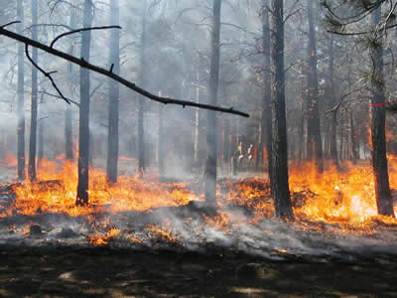
Effects of Fire
Creates and maintains a variety of different vegetation types
Essential in the germination of certain seeds
Allows for new growth in an old growth forest

Slide 8
Changes in Lake Ecosystems
Oligotrophic Lakes – deep, cold and low in nutrient levels
Eutrophic Lakes – generally shallow, warmer and high in nutrient levels
Eutrophication – the evolution from an oligotrophic lake to an eutrophic lake

Slide 9
Oligotrophic Lake

Slide 10
Mesotrophic Lake

Slide 11
Eutrophic Lake

Slide 12
Water Pollution
Human waste
Fertilizers
Household and industrial products
Thermal energy (heated water)
Water pollution is any physical or chemical change in surface water or ground water that can harm living things
See pg 116 for details

Slide 13
Biological Oxygen Demand (BOD)
BOD – a measure of the amount of dissolved oxygen needed by decomposers (bacteria) to break down organic matter in a sample of water at 20 C over 5 days
As the number of organisms increases, so does the BOD
High numbers of organisms = High BOD
High numbers of organisms = Less dissolved oxygen

Slide 14
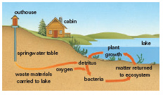
Changes in Alberta Lakes
Watershed – the land that drains toward a lake or other body of water

Slide 15
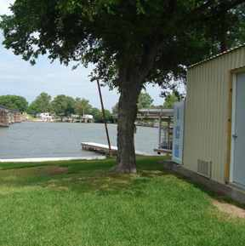
Effects of Cottage Dwellers on Alberta Lakes

Slide 16
Making sandy beaches increases erosion
Planting lawns increases nitrogen and phosphorus runoff from fertilizers
Removing shoreline plants takes away a filtering system for harmful chemicals moving from the land to the lake, decreases shade and thus affects water temperatures near the shore
Human sewage seeping from outhouses cause increased bacteria activity (less oxygen)

Slide 17
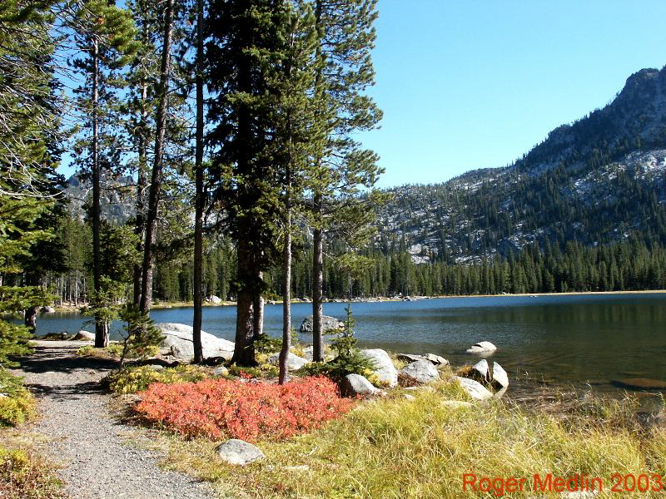
Questions
Do 4.5 Questions in Questions Booklet

