Slide 1
Classification of organisms 5.1
SLO: To explain the fundamental principles of taxonomy and binomial nomenclature, using modes of nutrition at the kingdom level and morphological characteristics at the genus species level

Slide 2
Why do we need to classify living things?
Scientists estimate that there are at least 10 million different species alive today.
With so many species, a means to classify organisms according to similarities is helpful.
Before we can study how populations change over time or evolve, we need to understand biological diversity – there are two types of diversity:
1) Species diversity – the number of different species there are
2) Genetic diversity – the amount of variation in inherited traits between members of the same species

Slide 3
Diversity!!!

Slide 4
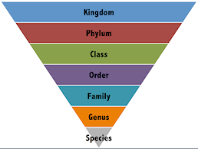
Taxonomy
The science of classification according to the inferred relationships among organisms

Slide 5
Carl Linnaeus
Based on an organism’s physical and structural features and operated on the idea that the more features organisms have in common, the closer their relationship.

Slide 6
Kings
Play
Cards
On
Fridays
Generally
Speaking

Slide 7
Binomial Nomenclature
Linnaeus created rules for assigning names to plants and animals using a two part scientific name using Latin words
This scientific name was based on characteristics like color or habitat
Example: Castor canadensis
Castor – means beaver and Canadensis – means from Canada

Slide 8
Scientific name Rules
The first part of the scientific name is the genus name and the first letter is always capitalized
The second part of the scientific name is the species name and is never used alone

Slide 9
Scientific Names: What they tell us
The scientific name can indicate if two organisms are closely related
The North American black bear: Ursus americanus and
The Grizzly Bear: Ursus horribilis
Are closely related and belong to the same genus

Slide 10
Fabric Classification

Slide 11
Species – the closest relationship
Organisms that belong to the same species are the most closely related
Members of the same species can usually only breed with members of their species and produce fertile young
* A horse and a donkey are not from the same species and though they can produce young – mules, the mules are not reproductively fertile

Slide 12
Practice!
Do question #7 on pg 139 of your text to test your understanding of scientific names

Slide 13
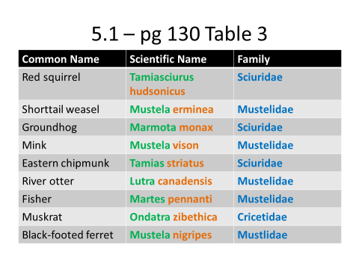

Slide 14
The Six Kingdoms
Originally the first level consisted of two kingdoms – Plantae and Animalia
With further discovery single celled organisms were added in the kingdom Protista
Later it was recognized that some single celled organisms did not have a true nucleus so another category was established for these organisms called Monera

Slide 15
The Six Kingdoms
Finally it was decided that within this last group of organisms lacking true nuclei, that there were 2 distinct groups so the group known as Monera were subdivided into Archaebacteria – those bacteria capable of living in harsh environments such as hot springs and the stomach chambers of cattle and Eubacteria that possess a rigid cell wall.

Slide 16
The Six Kingdoms

Slide 17
Phylogeny and Dichotomous Key
Phylogeny is the history of the evolution of organisms
Phylogenetic tree – starting from the most ancestral form and includes branching of all its descendents

Slide 19
Dichotomous Key
To help identify an organism, a dichotomous key can be used
It involves two questions which forms a series of choices that lead to another choice until the organism can be identified
Do dichotomous key activity to identify the creatures – complete only the first 5

