Slide 1
Evidence of Evolution from Biology
Living Organisms
5.3
Pgs. 144 - 149

Slide 2
Biological Evidence of Evolution
Embryology
Homologous and Analogous Features
Vestigial Features and Anatomical Oddities
Biochemical Evidence
Artificial Selection (Breeding)

Slide 3
Embryology

Slide 4
1. Embryology
The study of organisms in the early stages of development
Von Baer (a German scientist) said he could not differentiate between the embryos of lizards, birds and mammals
It was later suggested that similarities were due to their evolution from a common ancestor
Embryology helps identify homologous structures

Slide 5
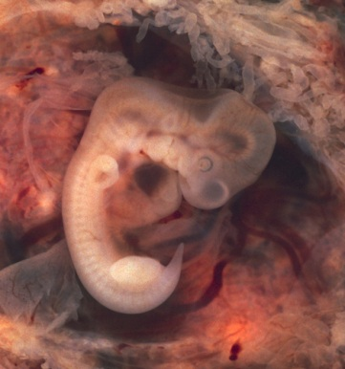
Human Embryos http://www.pbs.org/wgbh/nova/evolution/guess-embryo.html

Slide 6
2. Homologous and Analogous Features
Homologous Features
- Features with similar structures but different functions
- Example – flippers of a whale and arm of a human
Homologous structures are thought to have followed a process of divergent evolution

Slide 7
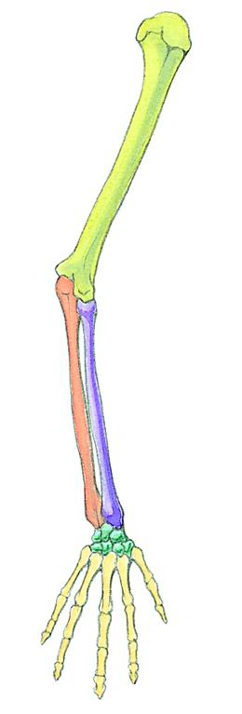
Homologous Features

Slide 8
Divergent Evolution
The process where two species with the same ancestor have developed with the same common ancestor have developed different forms and functions as a result of adaptations to different environments

Slide 9
Divergent Evolution
Common Ancestor
New species New species

Slide 10
Analogous Features
Features that are similar in appearance and function, but do not appear to have the same evolutionary origin
Example: wings of an insect and wings of a bird – have the same function but are structurally different
Analogous structures are thought to have evolved through a process of convergent evolution

Slide 11
Convergent Evolution
Independent evolution of traits based on adaptations to similar environments
separate species separate species
Common Traits

Slide 12
3. Vestigial Features and Anatomical Oddities
Vestigial features are rudimentary structures with no apparent useful function
This suggests that they once served some function in an ancient ancestor, but the organism evolved to function without the use of the structure
Human appendix
Whales and snakes have vestigial hip and leg bones

Slide 13
Whales have legs????

Slide 14
4. Biochemical Evidence
Based on the theory that all life came from one original cell
Genetic material (DNA) is similar in all organisms
This is “tested” by comparing the number of differences in amino acid sequences. The fewer differences, the closer related the organisms are. The more differences, the further apart the organisms are from a common ancestor

Slide 15
Example:
# of differences between human and cow: _____5_____
# of differences between human and monkey ____3_____
# of differences between monkey and cow _____5_____

Slide 16
5. Artificial Selection
The process of humans selecting and breeding individuals with specific desired traits.
Examples: plants – seedless water melon
Dogs: low shedding

Slide 17
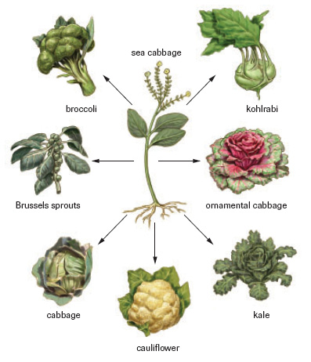
Artificial Selection

