Slide 1
5.5 – 5.6
Sources of Inherited Variation

Slide 2
Mutations
Mutations are random changes in DNA sequence in chromosomes
Sexual reproduction produces offspring by union of sex cells from 2 different parents – offspring inherit a combination of genes from both parents
DNA is the hereditary material of all living things, and is found in chromosomes of the cell
Bases are: Adenine (A), Thymine (T),
Cytosine (C) and Guanine (G)

Slide 3
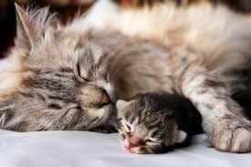
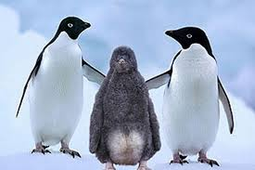
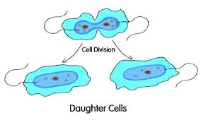
Sexual/Asexual Reproduction

Slide 4
Types of Mutations
Neutral mutations – have no immediate effect on an individual’s fitness or reproductive success
Harmful mutations – reduce an individual’s fitness
i.e. cancer – can be inherited or acquired (poor lifestyle)
Beneficial Mutations – give an individual a selective advantage
example: peppered moth
http://geoclio.org/ensci/imagesbook/03_03_moth_change.swf

Slide 5
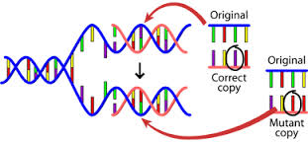
DNA Mutations

Slide 6
Sexual Reproduction
Asexual reproduction – individual reproduces without a mate
Small amount of variation only due to random mutations
Sexual reproduction – offspring are never identical to parents. Each parent contributes one copy of the gene to the offspring so the offspring is unique from either parent

Slide 7
These assortment of genes is determined randomly. The larger the number of genes (more complex organism) the greater the variability.
Variability is very important in a species’ survival against things like disease and changes in the environment

Slide 8
Speciation
Speciation – the formation of a new species
Allopatric speciation – speciation by reproductive isolation
The Rate of Evolution
Theory of Gradualism – idea that speciation takes place slowly with a series of small changes over time

Slide 9
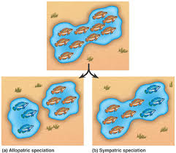
Allopatric Speciation

Slide 10
Speciation
Theory of Punctuated Equilibrium – idea that species evolve rapidly followed by a period of little or no change
Fossil record seemed to show that many species evolve very rapidly in evolutionary time
Speciation usually occurs in small isolated populations so intermediate fossils are rare

Slide 11
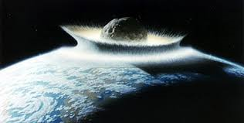
After an initial burst of evolution, species are well adapted to their environment and so do not change significantly over long periods of time or until a natural disaster significantly changes the environment
Example: asteroid impact and the loss of the dinosaurs

