Slide 1
7.2 Glycolysis
page 210

Slide 2
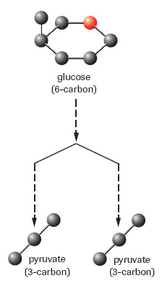
Glycolysis
Glycolysis is the first stage of cellular respiration
Glycolysis occurs with or without oxygen (during both aerobic and anaerobic respiration)
Glycolysis takes place in the cytoplasm of the cell
During glycolysis glucose is split in two to form 2 pyruvate molecules

Slide 3
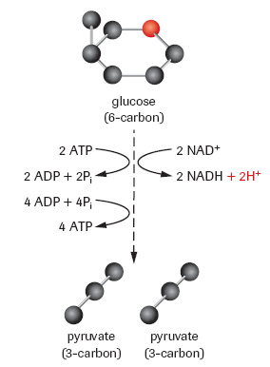
Glycolysis cont . . . .
Key Events
2 ATP are used
Oxidation – reduction reaction
2 NAD⁺ → 2NADH + 2H⁺
4 ATP are made
2 pyruvate molecules are made
Summary
IN → glucose
OUT → 2 ATP, 2 pyruvate, 2 NADH, 2 H⁺

Slide 4
Glycolysis cont . . . .
Reactants | Products
Glucose | 2 pyruvate
2 NAD+ | 2 NADH
2 ATP | 2 ADP
4 ADP | 4 ATP
Net equation for glycolysis
1 glucose + 2 ADP + 2 P_{i} + 2 NAD+ → 2 pyruvate + 2 ATP + 2 NADH + 2 H⁺

Slide 5
Glycolysis cont . . .
Glycolysis is not a highly efficient energy-harnessing mechanism.
Glycolysis only transfers about 2.2% of the energy in 1 glucose
Most of the energy is still stored in the 2 pyruvate molecules and the 2 NADH molecules
The energy produced by glycolysis is not enough to support multi-cellular organism, it is however enough to support some single celled organism.
Complete Questions 1 – 3 on page 212

