Slide 1
Aerobic Cellular Respiration
Chapter 7.3
Pages 213-220

Slide 2
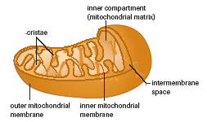
Mitochondria
Round or sausage shaped organelle
Specialize in the production of large quantities of ATP
Site of aerobic cellular respiration
ATP production requires free oxygen

Slide 3
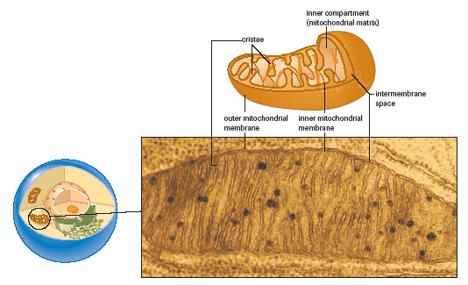
Mitochondria

Slide 4
Stage 2: Pyruvate Oxidation
A CO2 is removed from each pyruvate and released as a waste (1/3 of the CO2 that we breathe out)
NAD+ is reduced by two H atoms
Coenzyme A is attached to the remaining 2-carbon portion forming acetyl-CoA – which enter the Krebs cycle. The NADH proceeds to Stage 4 (electron transport and chemiosmosis)

Slide 5
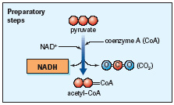

Slide 6
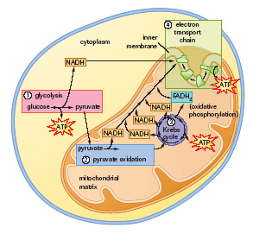

Slide 7
Practice Questions Page 215
What stages of aerobic cellular respiration take place in the mitochondria?
What happens to NAD+ in Stage 2 of aerobic cellular respiration?
What is the role of coenzyme A?
Answers:
Pyruvate oxidation, Krebs cycle and ETC and chemiosmosis
NAD+ gains two hydrogen ions and becomes NADH
Coenzyme A attaches to the acetic acid group (remaining 2-carbon portion) to become acetyl CoA which goes to the Krebs cycle.

Slide 8
Stage 3: The Krebs Cycle
Key Features of the Krebs Cycle
Since 2 molecules of acetyl-CoA are formed from one molecule of glucose, the Krebs cycle occurs twice for each molecule of glucose processed
As acetyl-CoA enters the cycle, the CoA is released and can be used for the next pyruvate
During one complete cycle a total of 3 NAD+s and 1 FAD are reduced to form 3 NADHs and 1 FADH2s
During one complete cycle an ADP and Pi are combined to form 1 ATP
During one complete cycle, 2 CO2 molecules are produced. These are released as waste

Slide 9
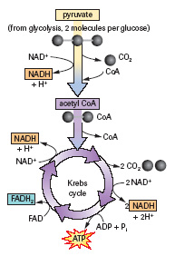
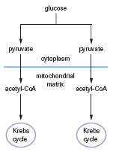
Krebs Cycle

Slide 11
Stage 4: Electron Transport and Chemiosmosis
NADH and FADH2 eventually transfer the hydrogen atom electrons they carry to the ETC (electron transport chain)
As the electrons are passed along carrier molecules, the energy released is used to pump hydrogen ions across the membrane through membrane pumps into the intermembrane space
The electrons are finally accepted by oxygen molecules and water is the byproduct of the electron transport chain

Slide 12
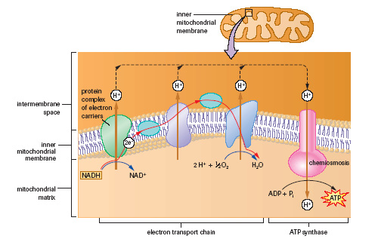
Electron Transport Chain (ETC)

Slide 13
Chemiosmosis and Oxidative ATP Synthesis
Hydrogen ions that accumulate in the intermembrane space form an electrochemical gradient
The protons are forced through a proton channel associated with the enzyme ATP synthase (ATPase)
The energy that is released forms ATP from ADP + Pi
One NADH generates three ATPs
One FADH2 generates two ATPs
Oxygen is needed to keep the electrons flowing through the ETC

Slide 14
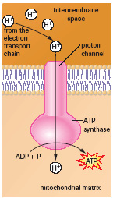
ATP Synthesis

Slide 15
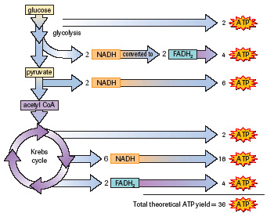
The Aerobic Respiration Energy Balance Sheet

Slide 16
Questions
How many ATP are formed in each cycle of the Kreb’s cycle?
A: one
How many NADH molecules are formed in each cycle of the Kreb’s cycle?
A: Three
How many FADH2 molecules are formed in each cycle of the Kreb’s cycle?
A: one

Slide 17
Questions
For every NADH molecule that reaches the ETC, how many ATP can be formed?
A: Three
For every FADH2 molecule that reaches the ETC, how many ATP can be formed?
A: Two
What acts as the electron acceptor at the end of the ETC that attracts electrons down the electron transport chain and that eventually forms into water?
A: O2

Slide 18
Questions
Where are the majority of ATP formed in aerobic cellular respiration?
A: In stage 4 – the ETC and chemiosmosis

