Slide 1
7.4 Anaerobic Respiration
p.221-228

Slide 2
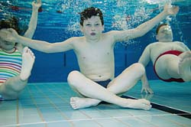
Why Anaerobic Cellular Respiration?
As the name suggests “an” = without, and “aerobic” = air. Anaerobic respiration is the cell’s way of acquiring energy when there are low oxygen levels

Slide 3
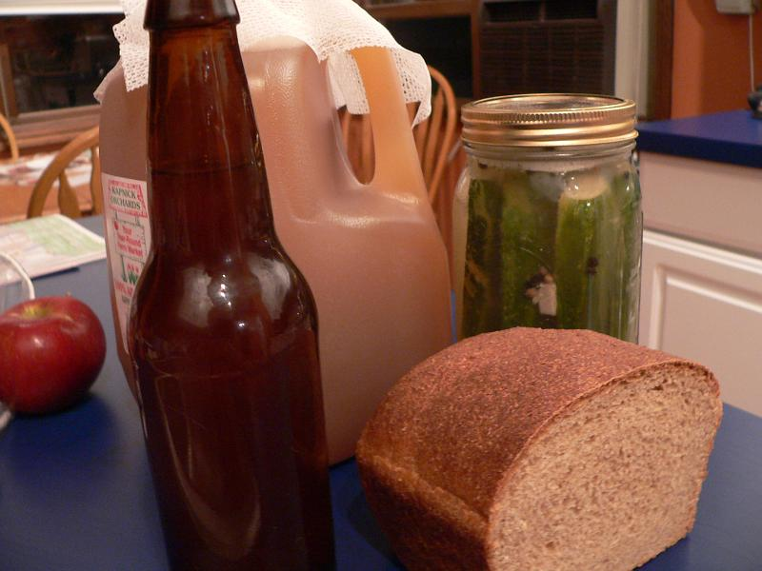
But really… why?
In aerobic organisms, NADH is converted to NAD+ by the electron transport chain, and that requires oxygen!
Some bacteria, and to a certain extent ourselves, aren’t able to do this. In such cases, NAD+ is recycled by a process called FERMENTATION.

Slide 4
Setting the Stage…
All fermentation occurs in two stages, each within the cytoplasm of the cell.
Stage 1: GLYCOLYSIS- the exact same 10-step process as used in aerobic respiration.
Stage 2: FERMENTATION- recycles the products of glycolysis in two different pathways where either carbon dioxide and ethanol (ALCOHOL FERMENTATION) or lactic acid (LACTIC ACID FERMENTATION) are the waste products

Slide 5
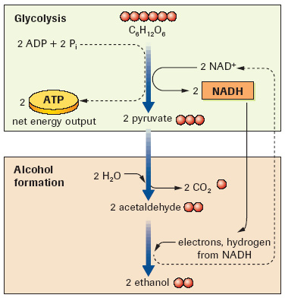
Option 1: Alcohol Fermentation C6H12O6 + 2ADP + 2Pi → 2 Ethanol (C2H5OH) + 2CO2 + 2 ATP
NADH molecules pass H+ atoms to acetaldehyde
Acetaldehyde is formed by removing a CO2 molecule from PYRUVATE.
The end product… ETHANOL! (the alcohol used in gasoline and beverages)
2 ATP are also produced which provide energy to the organism.

Slide 6
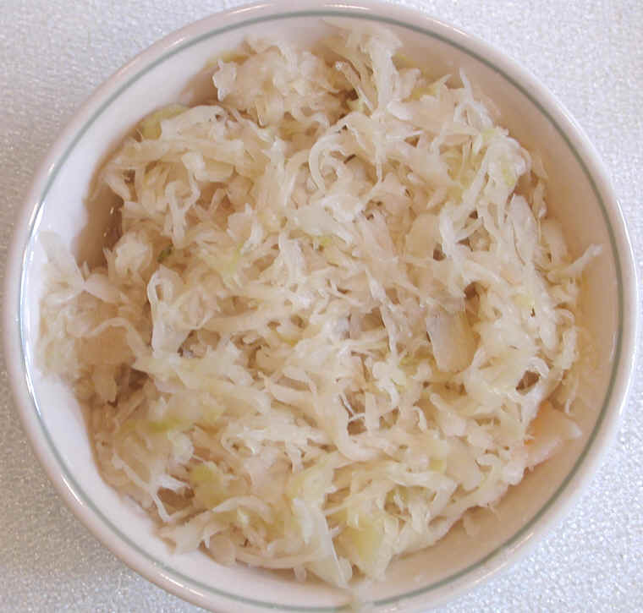
Applications of Alcohol Fermentation
Raw Material
Food
Flour/yeast →
Soya bean →
Cocoa bean →
Cabbage →
Grapes and barley →
bread
Soy sauce
Chocolate
Sauerkraut
Wine and beer

Slide 7
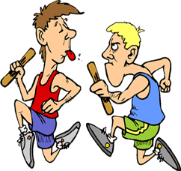
Feel the burn: Lactic Acid Fermentation
Most of the time humans rely on aerobic respiration and glycolysis for our ATP production, but occasionally during strenuous exercise, muscles demand more ATP than can be produced
Lactic Acid Fermentation supplements the body with additional ATP in these situations. PAINFUL!!

Slide 8
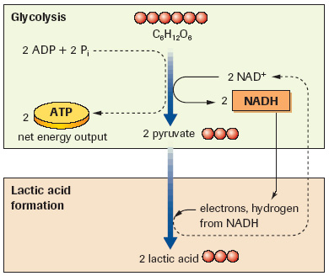
Option 2: Lactic Acid Fermentaion C6H12O6 + 2 ADP + 2Pi → 2 Lactic Acid (C3H6O3) + 2 ATP
NADH molecules pass their H+ to Pyruvate, which Changes Pyruvate into LACTIC ACID
Lactic acid build up causes stiffness, soreness and fatigue
Released into the bloodstream, it is processed in the liver back into pyruvate.
Pyruvate will eventually go through the remaining stages of aerobic respiration, once the exertion stops.
The extra O2 required to do this is what makes you breathe hard, even after you have stopped the strenuous exercise!

