Slide 1
Digestion
8.4 – Pages 264-270

Slide 2
Small Intestine
Longest section of the digestive tract (up to 7m long)
Composed of 3 sections:
Duodenum – 1st 25-30 cm is where most chemical digestion occurs
Jejunum and illium – where absorption happens
Digestive juices from the pancreas and liver, enter the small intestine at the duodenum.
Most absorption takes place in the small intestine
Surface area increases tenfold because of the villi and microvilli.
Food is moved through the small intestine using peristalsis.

Slide 3
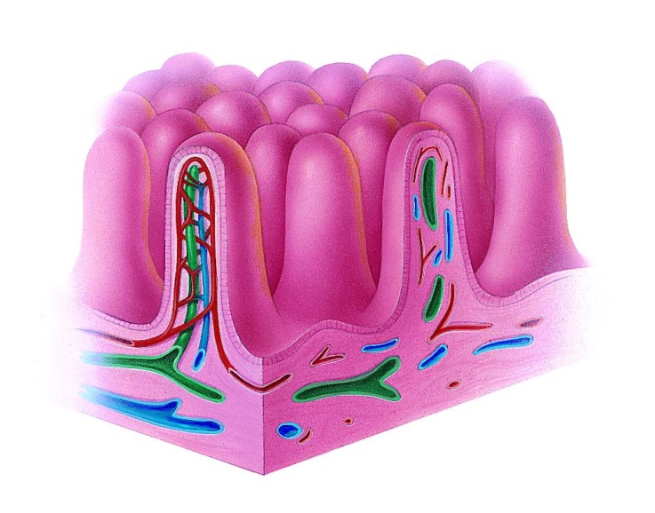
Small intestine – villi

Slide 4
Pancreas
As acids from the stomach enter the small intestine, chemical signals trigger a release of bicarbonate ions (HCO₃) from the pancreas and is carried to the small intestine. This buffers the mixture of HCl and undigested food changing the pH from about 2.5 – 9.0.
Secretes insulin to regulate blood sugars
Secretes enzymes to digest fats, proteins and some sugars

Slide 5
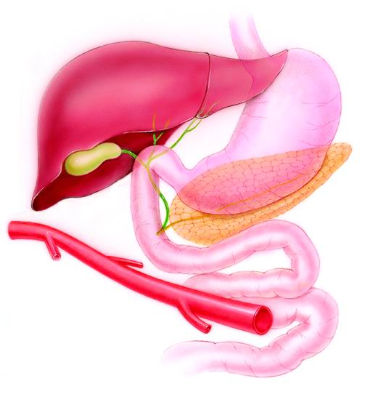
Pancreas: https://www.youtube.com/watch?v=NZ4zcrTzUjA
Pancreas

Slide 6
Liver
Largest glandular organ in the body
Produces bile – greenish – yellow substance that helps digest fats
Bile is carried from the liver to the small intestine
Manufactures blood proteins
Stores glucose as glycogen
Breaks down toxins (alcohol)
Breaks down hemoglobin – this gives feces the characteristic brown color

Slide 7
Liver: https://www.youtube.com/watch?v=tat0QYxlCbo
Liver

Slide 8
Gallbladder
Small muscular sac beneath the liver
Stores and concentrates bile
Bile emulsifies fat (physical break down of fats into smaller fat droplets)
Gallstones are large bile salt crystals that can block the bile duct

Slide 9
Gallbladder
Gallbladder

Slide 10
Large Intestine
Storage and elimination of undigested waste (feces)
Reabsorption of water
Bacteria live in the colon that synthesize vitamins B and K
Fibre in the diet is essential to ensure frequent bowel movements which do not allow waste to remain in the body for any length of time

Slide 11
Enzymes and where they are produced: Textbook pg. 266
Enzyme | Produced by | Reaction
Lipase |  | Fat droplets → glycerol + fatty acids
Trypsin
Erepsin
Pancreatic amylase
maltase

Slide 12
Digestive organs and their functions: Textbook pg. 270
Organ | Function
Mouth
Stomach
Small intestine
Pancreas
Large intestine

