Slide 1
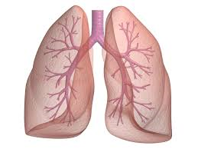
9.2 pages: 288-291
Gas Exchange and Transport

Slide 2
Dalton’s Law of Partial Pressure
Each gas in a mixture exerts it’s own pressure, which is proportional to the total volume (of the mixture)
Gases diffuse from an area of high partial pressure to an area of lower partial pressure
Oxygen moves from the atmosphere, the area of highest pressure, to the alveoli.

Slide 3
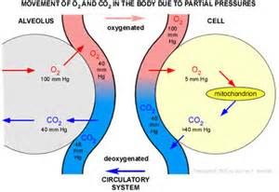
Partial Pressure of O2 and Co2

Slide 4
Gas moves from high pressure to low pressure
High pressure of O₂ in your arteries moves
into your body cells
High pressure of CO2 in your body cells so it moves into your veins
Oxygen moves from the capillaries into the cells to supply the tissue with oxygen

Slide 5
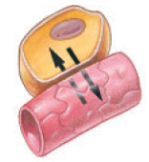

Slide 6
Oxygen Transport
Oxygen from the atmosphere→ alveoli→ blood
Hemoglobin – the oxygen carrying molecule in red blood cells
When oxygen dissolves into the plasma, hemoglobin forms a weak bond with the oxygen molecule to form oxyhemoglobin
This can allow the blood to carry 20 mL of oxygen per 100 mL of blood

Slide 7
Blood diffusing into the capillaries from the lungs drops pressure to about 5.3 kPa from about 13.3 kPa in the lungs
This drop in partial pressure causes the dissociation, or split, of oxygen from the hemoglobin and oxygen diffuses into the tissues

Slide 8
Carbon Dioxide Transport
27% of CO₂ is carried in red blood cells
64% of CO₂ is converted by carbonic anhydrase to carbonic acid H₂CO₃
converting CO₂ into carbonic acid (H₂CO₃) decreases the concentration of CO₂ in the blood so that CO₂ will continue to move into the blood . . BUT . . it decrease the pH which can be potentially deadly

Slide 9
Hemoglobin as a Buffer
Carbonic acid H₂CO₃ dissociates/splits into H⁺ and HCO₃
Hemoglobin picks up the H⁺ ions, working to neutralize the blood’s pH levels (buffers blood so that it is not acidic)
When the hemoglobin reaches the lungs H⁺ is replaced by O₂
CO₂ and H₂O are released into the lungs and exhaled

Slide 10
