Slide 1
Allergic Response
HCS2100
SLO: 3.9
Notes:
Motion
(Basic)
Note: This video template is optimized for Microsoft PowerPoint 2010.
In PowerPoint 2007, video elements will play, but any content overlapping the video bars will be covered by the video when in slideshow mode.
In PowerPoint 2003, video will not play, but the poster frame of the videos will remain in place as static images.
The video:
Plays automatically after each slide transition.
Is 15 seconds long.
Seamlessly loops for infinite playback.
To add slides or change layout:
To add a new slide, on the Home tab, in the Slides group, click the arrow under New Slide, then click under Motion Background Theme, then select the desired layout.
To change the layout of an existing slide, on the Home tab, in the Slides group, click Layout, then select the desired layout.
Other animated elements:
Any animated element you insert will begin after the slide transition and the background video has started.

Slide 2
Allergy
Allergy involves antigens and antibodies
Allergy or hypersensitivity – a tendency to react unfavorably to certain substances that are normally harmless to most people

Slide 3
Allergic Reaction
Allergens cause allergic reactions and are like antigens
Like most antigens, they are usually proteins
Examples of allergens:
pollen
house dust
animal dander
certain food proteins
certain drugs - penicillin

Slide 4
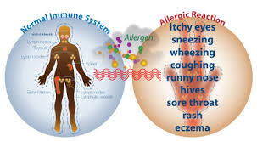

Slide 5
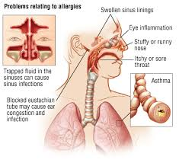
The Immune System Response
When a susceptible person’s tissues are repeatedly exposed to an allergen; an example is exposure of mucosa to pollens – those tissues become sensitized; that is, antibodies are produced in them

Slide 6
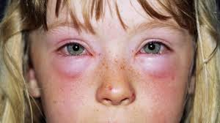
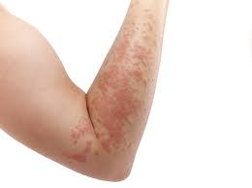
When the next exposure to the allergen occurs, there is an antigen-antibody reaction
Normally, this type of reaction takes place in the blood without harm, as in immunity
In allergy, however, the antigen-antibody reaction takes place within the cells of the sensitized tissues, with results that are disagreeable and sometimes dangerous

Slide 7
Antigen-Antibody Reactions
There is a release of excessive histamine
Histamine causes dilation and leaking from capillaries as well as contraction of involuntary muscles (example: in the bronchi)
Antihistamines are drugs that counteract histamine and may be effective in treating the symptoms of certain allergies

Slide 8
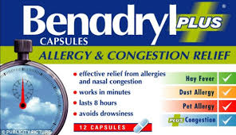

Slide 9
Desensitizing
Sometimes it is possible to desensitize an allergic person by repeated intermittent injections of the offending allergen
Unfortunately, this form of protection does not last long

Slide 10
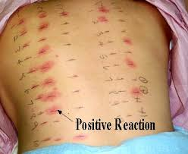
Allergy Testing

Slide 11
Anaphylaxis
A life threatening allergic response in a sensitized individual
Any allergen can provoke an anaphylactic response, but common causes are drugs, insect venom and foods
Symptoms can appear within seconds to minutes after contact

Slide 13
Anaphylaxis
Symptoms can include:
Breathing problems
Swelling of the throat and tongue
Edema
Decreased blood pressure
Cardiovascular shock
Anaphylaxis is treated with injectable epinephrine, antihistamine, administration of oxygen and plasma expanders to increase blood pressure

Slide 14
