Slide 1
Basic anatomy and function of the nervous system
HCS 2050
SLO: 1.0 – Explain the basic anatomy and function of the nervous system
SLO: 1.4 - Explain the structure and function of neurons and neuroligia

Slide 2
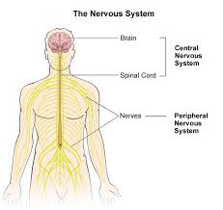
Central and peripheral nervous system

Slide 3
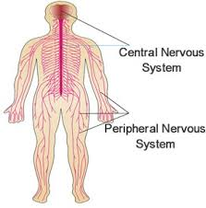
Central Nervous system
CNS – includes the brain and the spinal cord

Slide 4
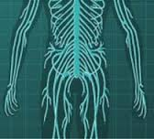
Peripheral nervous system
PNS – made up of all the nerves outside of the central nervous system.

Slide 5
Functional Divisions of the PNS
The PNS is divided according to whether the action is voluntary or involuntary
An effector is any tissue or organ that carries out a nervous system command.
The somatic nervous system is controlled voluntarily and all of its effectors are skeletal muscles

Slide 6
Peripheral Nervous system
The autonomic nervous system (ANS) is controlled involuntarily and is sometimes called the visceral nervous system because its effectors are smooth muscle, cardiac muscle and glands found in the soft body organs.

Slide 7
Practice
Complete workbook pg 149 Exercise 9-1
and pg 150 (top only) Exercise 9-2

Slide 8
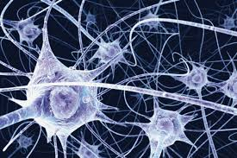
Neurons
The cells within the nervous system are called neurons.

Slide 9
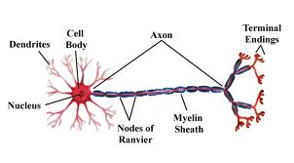
Structure of a neuron

Slide 10
Practice
Label and color the diagram of a motor neuron on the bottom of workbook pg. 150 – Exercise 9-3

Slide 11
Neuron Structures
Cell Body – contains the nucleus and other organelles typically found in cells
Dendrites – neuron fibers that conduct impulses to the cell body. These appear branched or tree like.
Dendrites function as receptors in the nervous system. They receive a stimulus that begins a neural pathway

Slide 12
Neuron Structures
Axons – neuron fibers that conduct impulses away from the cell body
- These impulses may be delivered to another neuron, to a muscle or to a gland
- An axon appears as a single fiber that can be quite long and have branches and its end (terminal ending) is branched

Slide 13
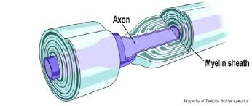
Neuron structure
Myelin Sheath – some axons are covered with a fatty material called myelin that insulates and protects the fiber

Slide 14
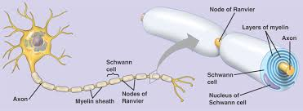
Neuron structure
In the PNS myelin is formed by specialized cells known as Schwann cells
The gaps between the Schwann cells form nodes called nodes of Ranvier

Slide 15
Neurilemma
Neurilemma is the outmost thin coating of the Shwann cells
This is found in the PNS and is how some nerve cell fibers can regenerate after injury
Because cells of the brain and the spinal cord are myelinated by cells other than Shwann cells, they have no neurilemma and so if they are injured, the damage is almost always permanent

Slide 16
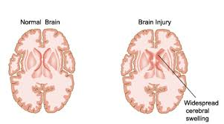
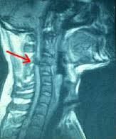
Spinal and Brain Injuries

