Slide 1
Cellular Respiration
Chapter 7.1
Pages 202-209

Slide 2
Learner Outcomes:
To explain the role of cellular respiration in releasing potential energy from organic compounds
To summarize and explain the role of ATP in cellular metabolism
- active transport, cytoplasmic streaming, phagocytosis, biochemical synthesis, muscle contraction, heat production
To distinguish, in general terms, between aerobic and anaerobic respiration and fermentation in plants, animals and yeast

Slide 3
The Importance of Cellular Respiration
When cells require energy for a particular process, it must be supplied in the more directly usable form of ATP
The cells of both animals and plants release the energy stored in the bonds of glucose molecules through the process of cellular respiration

Slide 4
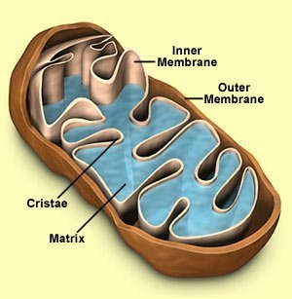
Cellular Respiration
Glucose + oxygen → carbon dioxide + water + energy
C6H12O6 + 6O2 → 6CO2 + 6H2O + energy (ATP)

Slide 5
Electron Carriers
NADH is a reduced form of NAD+ (nicotinamide adenine dinucleotide)
FADH2 is the reduced form of FAD+
(flavin adenine dinucleotide)
These compounds serve as electron carriers through oxidation-reduction reactions

Slide 6
The transfer of electrons from one reactive atom to another produces more stable ions or compounds
Energy is released during oxidation-reduction reactions
This energy can be used to make ATP
ADP + Pi → ATP

Slide 7
Questions
What is the primary function of cellular respiration?
How do the oxidation and reduction reactions in electron transfer help form ATP?

Slide 8
Answers
To convert solar energy from glucose molecules into ATP
Each time electrons are transferred in oxidation-reduction reactions, energy is made available for the cell to make ATP

Slide 9
Energy, Cells and ATP
Active transport moves substances against the concentration gradient into or out of the cell using ATP and carrier proteins often referred to as ‘pumps’.
Example: sodium-potassium pump

Slide 10
Other Processes that Require ATP
Chromosome movements during cell division
Movement of organelles such as contractile vacuoles
https://www.youtube.com/watch?v=9Ynm5ZOW59Q
Cytoplasmic streaming
https://www.youtube.com/watch?v=0WCWgMqouaI
Formation of pseudopods
https://www.youtube.com/watch?v=iGhm01oR2q0
Beating of cilia and flagella
Contraction of skeletal, smooth and cardiac muscles

Slide 11
Joining amino acids in protein synthesis
Building new strands of DNA during DNA replication
Switches certain enzymes on or off
Produces light in some light-generating species such as glow-worms and fireflies

Slide 12
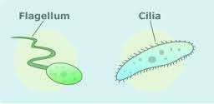
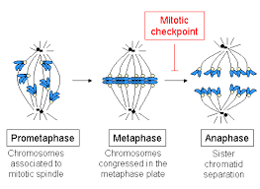
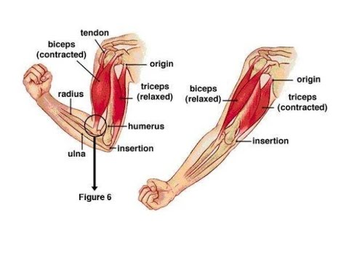
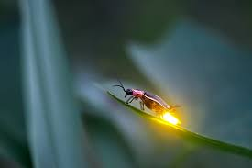
Examples of uses of ATP

Slide 13
Glucose and ATP
Virtually all processes conducted by cells use ATP molecules.
Glucose can not be used directly by cells
Glucose has the equivalence of 100 times the energy of one ATP molecule
Glucose must be converted into ATP so it can be used by the cell

Slide 14
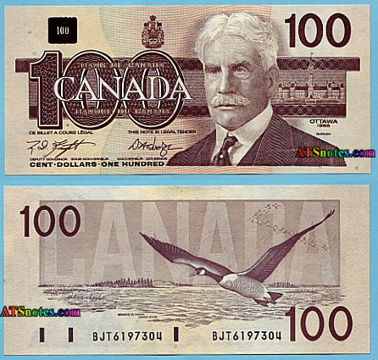
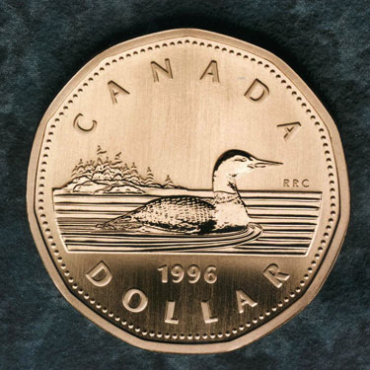

Slide 15
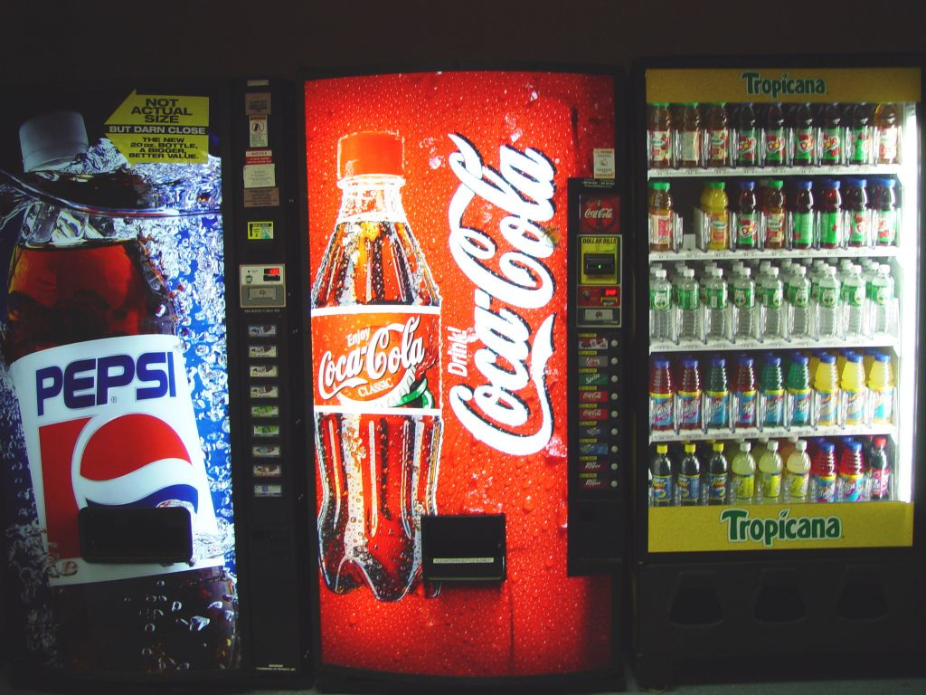
Vending Machine Analogy
Cells are like vending machines – they can only accept one dollar coins (ATP)
Glucose is like $100 bill – we need to get change in the form of dollar coins (ATP) before the vending machine (cell) can use it.

Slide 16
Questions:
Active transport involves carrier proteins imbedded in the membranes of cells. How do these carrier proteins use ATP to transport molecules across the membrane?
How is ATP used in muscle contraction?
One glucose molecule has 100 times more stored energy than one ATP molecule. Explain why cells can’t use glucose to run their processes.

Slide 17
Answers
The energy from ATP is used by the pump to move molecules against the concentration gradient, resulting in the formation of ADP and Pi
ATP causes muscle fibres to pull against one another, resulting in contraction
The ATP molecule contains the energy in smaller amounts that are usable by the cell for cell processes

Slide 18
Releasing Energy
During cellular respiration, energy is released as the high energy glucose molecule is broken down into lower energy molecules
In accordance with the Second Law of Thermodynamics, no energy conversion can be 100% efficient – cellular respiration is about 36% efficient at converting glucose into the energy of ATP
The remaining 64% is released as heat, which in the case of mammals and birds, maintains our constant body temperature

Slide 19
Two Types of Cellular Respiration
Aerobic Cellular Respiration – the set of reactions that take place in the cell in the presence of oxygen and releases energy stored in glucose
The end products of aerobic cellular respiration are carbon dioxide gas, water and 36 ATP molecules
C6H12O6 + 6O2 + 36 ADP + 36 Pi → 6CO2 + 6H2O + 36 ATP

Slide 20
Aerobic Cellular Respiration Stages
Stage 1: glycolysis
Stage 2: pyruvate oxidation
Stage 3: the Krebs cycle
Stage 4: the electron transport chain and chemiosmosis

Slide 21
Anaerobic Cellular Respiration
The set of reactions that take place in the cell in the absence of oxygen and releases energy stored in glucose
There are two types of anaerobic cellular respiration:
C6H12O6 + 2ADP + 2Pi → 2C2H5OH + 2CO2 + 2ATP
(ethanol)
C6H12O6 + 2ADP + 2Pi → 2C3H6O3 + 2 ATP
(lactic acid)

Slide 22
Anaerobic Cellular Respiration Stages
Stage 1: glycolosis
Stage 2: fermentation
* Aerobic cellular respiration produces much more ATP than either anaerobic cellular respiration

Slide 23
Assignment:
Do 7.1 Questions #1 – 5
Page: 209

Slide 24
Assignment Answers
Glucose has a high energy content, is relatively small, and is highly soluble.
Both animals use the waste energy (heat) to keep their bodies warm.
Example:
- the movement of material up the concentration gradient (low concentration to high) Sodium/Potassium pumps

Slide 25
4. Cellular respiration is required to convert stored food energy (glucose) into the usable form of ATP
5. Glycolysis, pyruvate oxidation, Kreb’s cycle and the electron transport chain and chemiosmosis

