Slide 1
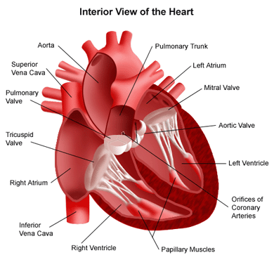
Chapter 10 circulatory system
Pgs. 310 - 339

Slide 2
10.1 – Blood Vessels

Slide 3
Arteries and Arterioles
Arteries
* Carry blood away from the heart
* Thick walls composed of distinct layers
* Outer and inner layers primarily made of connective tissue
* Middle layers made up of muscle fibres and elastic connective tissue
* Arteries stretch to accommodate the inrush of blood

Slide 4
Arteries vs. Veins

Slide 5
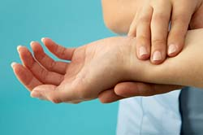
Pulse
Change in the diameter of the arteries following heart contractions
Can be felt near your wrist and on either side of your neck

Slide 6
Arterioles – smaller arteries
Autonomic nervous system – the part of the nervous system that controls the motor nerves that regulate equilibrium, and that is not under conscious control
Vasoconstriction – the narrowing of blood vessels, allowing less blood to the tissues
example: becoming pale when frightened – constriction of the arteriolar muscles diverts blood away from the outer capillaries of the skin toward the muscles.

Slide 7
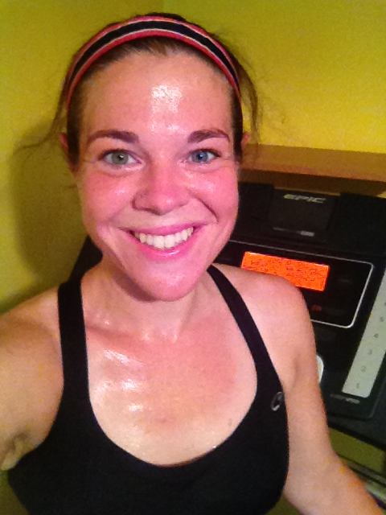
Vasodilation – the widening of blood vessels, allowing more blood to the tissues
Example: flushing with exercise – vasodilation of arterioles leading to skin capillaries and red blood cells close to the surface of the skin produces a pink color

Slide 8
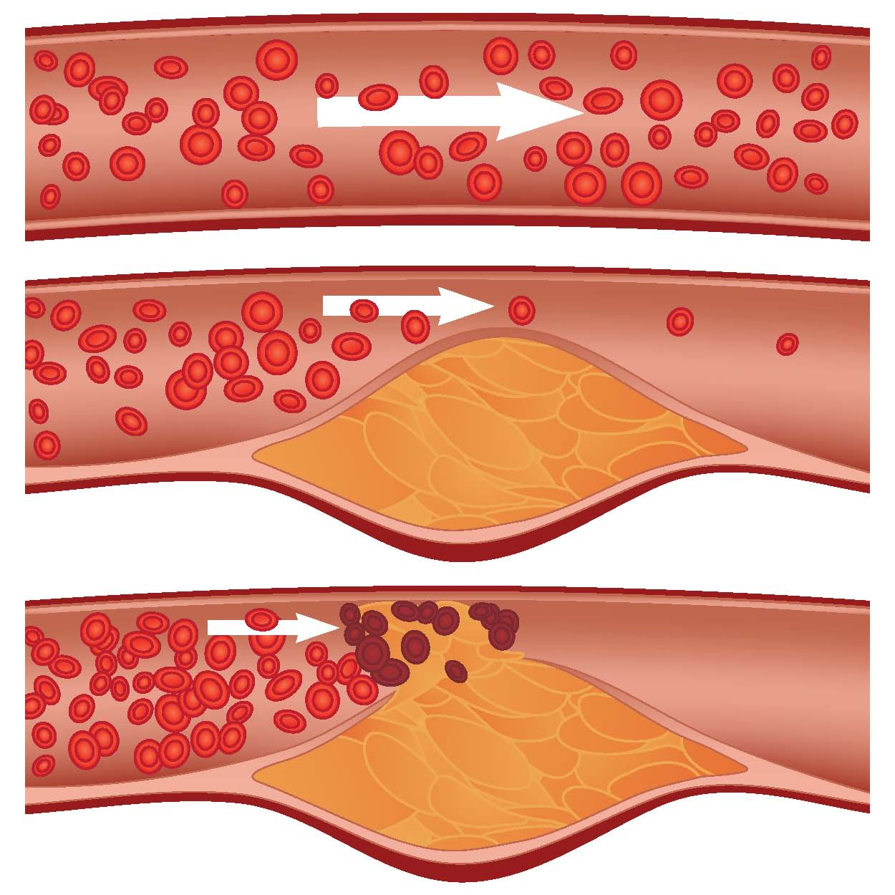
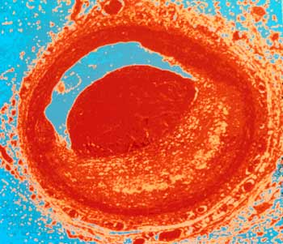
Atherosclerosis – a degeneration of blood vessels caused by the accumulation of fat deposits in the inner wall

Slide 9
Arteriosclerosis – a group of disorders that cause the blood vessels to thicken, harden, and lose their elasticity
* Can narrow arteries
* Can cause high blood pressure
* Blood clots can lead to the bursting of artery walls
* In the heart, narrowed or blocked arteries can lead to limited blood and oxygen flow to the heart causing chest pain or heart attack

Slide 10
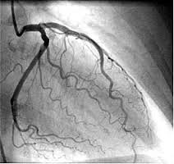
Cardiac Catheterization and Stent placement

Slide 11
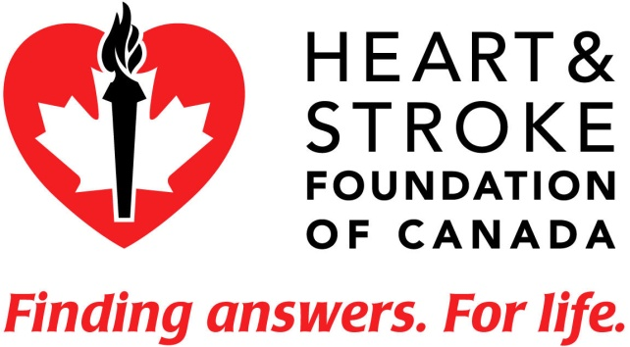
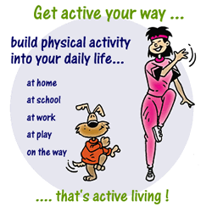
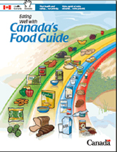
Heart Disease
* Every year heart disease kills more Canadians than any other disease.
* A low-fat diet and exercise are keys to prevention.

Slide 12
Aneurysm – a bulge in the weakened wall of a blood vessel, usually an artery
* Most common sites: aorta of the heart, abdominal aorta and arteries of the brain
* Most commonly caused by artherosclerosis
* An aneurysm in the brain is one of the conditions that can cause a stroke

Slide 13
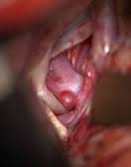
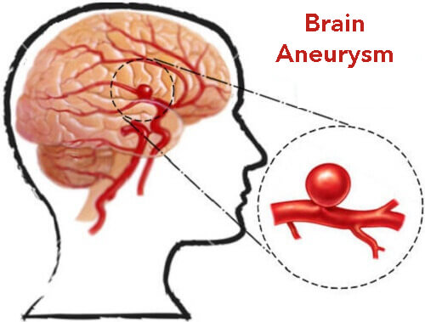
Aneurysm

Slide 14
Five Signs of Stroke
Stroke can be treated. That’s why it is so important to recognize and respond to the warning signs.
Weakness - Sudden loss of strength or sudden numbness in the face, arm or leg, even if temporary.
Trouble speaking - Sudden difficulty speaking or understanding or sudden confusion, even if temporary.
Vision problems - Sudden trouble with vision, even if temporary.
Headache - Sudden severe and unusual headache.
Dizziness - Sudden loss of balance, especially with any of the above signs.
If you experience any of these symptoms, CALL 9-1-1 or your local emergency number immediately.

Slide 15
Capillaries
Smallest blood vessels (red blood cells must travel through capillaries in single file)
Only one cell thick
Site of fluid and gas exchange between blood and body cells
Capillary beds are very delicate and can be easily damaged by pressure or impact (bruise)
Oxygenated (oxygen rich) blood appears red
Deoxygenated (oxygen poor) blood appears purple-blue
Deoxygenated blood collects in small veins called venules and is carried back to the heart

Slide 16
Capillaries

Slide 17
Veins and Venules
Walls contain smooth muscle
Venules merge into veins with larger diameters
As blood flows from arteries to arterioles to capillaries, blood flow is greatly reduced and blood pressure in these smaller vessels is low
The pressure is not great enough to push blood back to the heart
Veins have valves that open in one direction, steering blood back to the heart
Skeletal muscles aide in blood flow in veins by creating a massaging action directing blood flow toward the heart.

Slide 18
Veins

Slide 19
Blood Flow

Slide 20
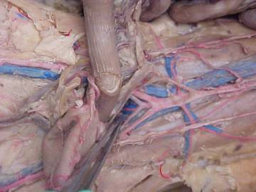
Arteries and Veins

Slide 21
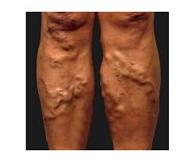
Varicose veins
https://www.youtube.com/watch?v=VPeXRCc8w24

Slide 22
Questions
Page 316 # 1-3
Page 318 # 3, 5 – 9
*Note: to answer question #8 you must read the last paragraph on pg. 317

