Slide 1
Chapter 10.2 Part 2

Slide 2
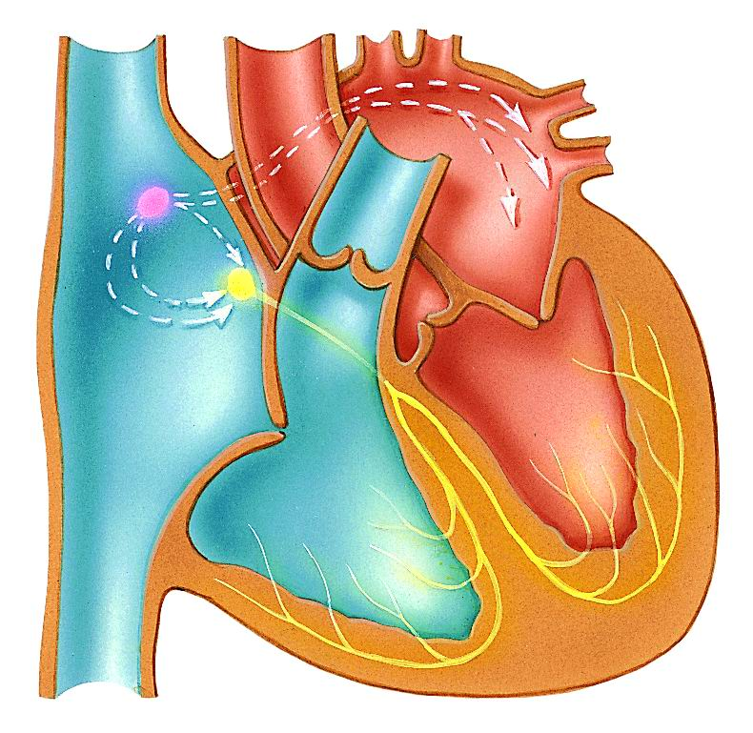
The Heart’s Tempo
The heart rate is set by the sinoatrial node (SA node)
This bundle of nerves and muscles are found in the upper right atrium and acts as the heart’s pacemaker
SA Node
(Pacemaker of the heart)

Slide 3
The Heart’s Tempo
The SA node stimulates the two atria to contract and then relays the signal to the second node – the atrioventricular node (AV node) located in the septum separating the two atria.
AV node

Slide 4
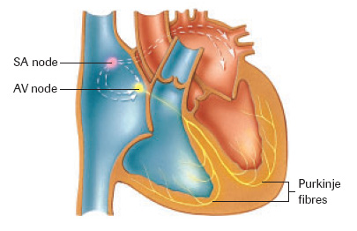
The Heart’s tempo
The AV node passes the nerve impulses down the Purkinji fibers through the septum stimulating the two ventricles to contract.

Slide 5
The Autonomic Nervous system
Heart rate is affected by the autonomic nervous system:
Sympathetic Nervous System is stimulated during times of stress
- increases heart rate (Fight or Flight)

Slide 6
The Autonomic Nervous System
Parasympathetic Nervous System is stimulated during times of relaxation
- Slows heart rate back to normal levels (Rest and digest)

Slide 7
Heart Sounds “Lubb dub”
The characteristic heart sounds are caused by the closing of the heart valves.
A heart murmur is when the valves do not close properly and blood leaks back into the atria from the ventricles
This causes a gurgling sound that can be detected with a stethoscope

Slide 8
Cardiac cycle
Systole – the part of the cycle where blood is pushed out of the heart by the contraction of the ventricles
Diastole – the part of the cycle where the ventricles relax and fill with blood

Slide 9
Do Reading Questions 10.2

