Slide 1
Medical Studies 20
HCS 2920 Project C
Vital Signs

Slide 2
Part 1 The Four Vital signs of body function are:
Temperature
Pulse
Respirations
Blood pressure

Slide 3
Vital signs
A person’s vital signs can vary within certain limits and can be affected by medications, pain, illness, activity, exercise, sleep, foods, fluids, smoking and emotions (excitement, fear, anger and anxiety)

Slide 4
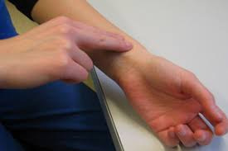
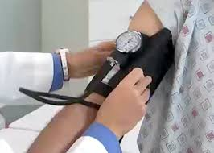
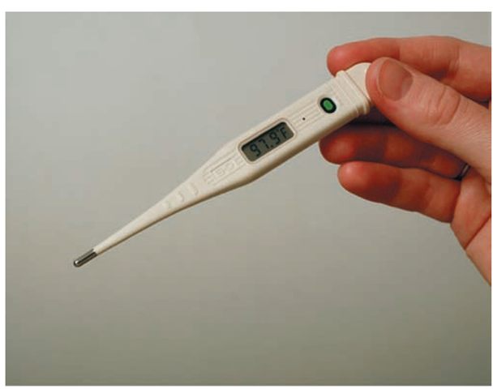
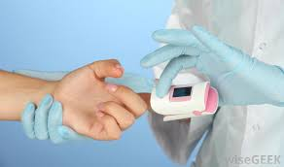
Vital signs are measured to detect changes in normal body function. They can indicate response to treatment and signal life-threatening events

Slide 5
Vital signs are part of the assessment process and are measured:
During physical examinations
When a client/patient is admitted to a facility
Several times a day for hospital clients/patients
Before and after surgery
Before and after complex procedures or diagnostic tests

Slide 7
Vital signs are part of the assessment process and are measured:
After a fall or injury
When medications that could affect the respiratory or circulatory system are taken
Whenever a client/patient complains of pain, dizziness, light-headedness, shortness of breath, rapid heart rate or not feeling well
As directed by the doctor

Slide 8
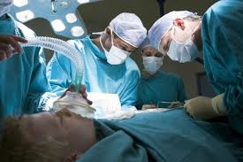

Slide 9
When to Report
You should always compare readings to the client/patient’s baseline reading
When any vital sign is changed from a previous measurement
When vital sign is below the normal range

Slide 10
Normal Ranges of Vital signs

Slide 11
Body Temperature
The amount of heat in the body
Temperature is measured in degrees Celsius
Can be affected by:
age Pregnancy
Menstruation Weather
Emotions Exercise
Stress

Slide 12
Temperature sites
Mouth – oral temperature
Ear – tympanic temperature
Underarm – axillary temperature

Slide 13
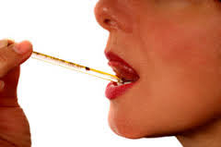
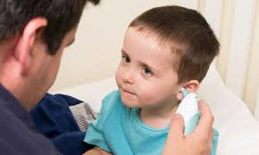
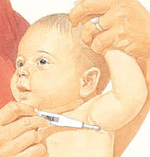
Temperature Sites

Slide 14
Questions
When would it not be advisable to take oral temperature?
A: unconscious, injury/surgery to mouth, has a nasogastric tube, is delirious or agitated etc.
What could temporarily affect oral temperature readings?
A: eating/drinking hot or cold foods, smoking, chewing gum

Slide 15
Your Turn!
You will need to take the body temperature of 2 individuals in the class using both an oral thermometer taking axillary temperature and a digital ear thermometer
Record both readings on your record sheet
Were the two readings significantly different from one another?
What factors would you need to consider before choosing the thermometer that you would use?

Slide 16
Pulse
Pulse is the beat of the heart felt at an artery as a wave of blood passes through the artery
Pulse rate is the number of heartbeats or pulses felt in 1 minute
Normal Adult pulse rate range is between 60-100 beats per minute

Slide 17
Pulse Ranges for different ages
Age | Pulse Rate (beats per minute)
Infant | 120-160
Toddler | 90-140
Preschooler | 80-110
School-aged child | 75-100
Adolescent | 60-100

Slide 18
Factors affecting pulse rate
Elevated body temperature (caused by fever or exposure to hot environment)
Exercise
Pain
Position change (pulse rate temporarily increases when a patient/client sits or stands after lying down)
Caffeine
Emotions (excitement, fear, anger, anxiety)
Medications (can increase or slow down pulse)

Slide 19
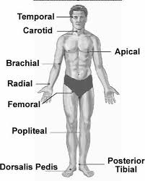
Sites for taking pulse
You can feel pulse by placing your fingertips over certain sites on the body

Slide 20
Types of Heart Rates
Tachycardia – rapid heart rate – over 100 beats per minute
Bradycardia – slow heart rate – less than 60 beats per minute
Dysrhythmia – irregular, beats are unevenly spaced or beats are skipped
Force and strength – a forceful pulse is easy to feel and is described as strong, full or bounding
- a hard-to-feel pulse is described as weak, thread or feeble

Slide 21
Your Turn
Take your own pulse (carotid and radial) and record it on your sheet
Take the radial pulse of two other classmates and record them on your sheet also describe the pulse in terms of force
Attempt to find pulse in other locations other than carotid or radial
When would taking pulse at these other locations be necessary?
A. If the patient had injuries at the other sites. If taking pulse in the other locations was necessary to determine circulation.

Slide 22
Blood Pressure (Vital signs part 2)
The amount of force exerted by the blood against the walls of an artery.
Systole –the period of heart muscle contraction
Diastole- the period of heart muscle relaxation

Slide 23
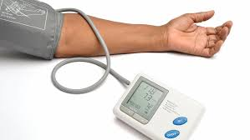
Blood pressure
Systolic pressure – the higher pressure that represents the amount of force needed to pump blood out of the heart
Diastolic pressure – the lower pressure that represents the pressure in the arteries when the heart is at rest

Slide 24
Factors affecting blood pressure
Age – blood pressure increases with age
Gender – women usually have lower blood pressure than men
Blood volume – the amount of blood in the system. Severe bleeding lowers blood pressure. Giving IV fluids increases blood volume and raises blood pressure

Slide 25
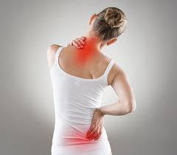
Factors affecting blood pressure
Stress – includes anxiety, fear and other emotions can increase blood pressure
Pain – generally increases blood pressure. However, severe pain can cause shock and blood pressure can be seriously lowered
Exercise – increases blood pressure so measuring blood pressure should not be done immediately after exercise

Slide 26
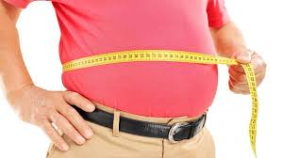
Factors affecting blood pressure
Weight – blood pressure is higher in overweight people and is lowered by weight loss
Ethnicity – blood pressure tends to be higher among Canadians of South Asian, Aboriginal or African descent
Diet – a high-sodium diet increases the amount of water in the body causing increases in blood pressure

Slide 27
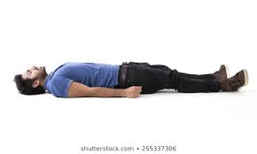
Factors affecting blood pressure
Medications – can be given to raise or lower blood pressure. Other medications can cause high or low blood pressure
Position – blood pressure is lower when lying down and higher when standing
Smoking – increases blood pressure. Nicotine causes vessels to constrict or narrow making it harder for the heart to pump blood through them

Slide 28
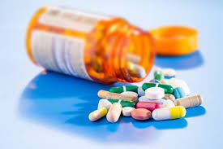
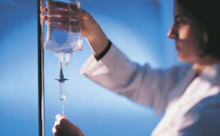
Factors affecting blood pressure
Alcohol – excessive alcohol intake can raise blood pressure

Slide 29
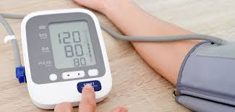
Normal ranges of Blood pressure
For adults:
Systolic pressure – between 100-140 mm Hg
Diastolic pressure – between 60-90 mm Hg

Slide 30
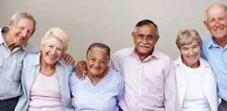
Older adults
With aging, arteries narrow and lose their elasticity, so the heart has to work harder to pump blood through the vessels. As a result, both systolic and diastolic pressures are higher in older adults – a blood pressure of 160/90 is considered normal for most older adults.

Slide 31
Equipment
A sphygmomanometer and a stethoscope.
The sphygmomanometer consists of a blood pressure cuff and a measuring device (manometer)
There are 3 types of manometers – aneroid, mercury and electronic

Slide 32
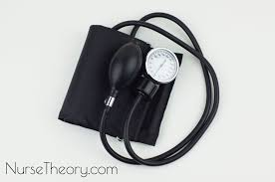
Equipment
Aneroid manometer

Slide 33
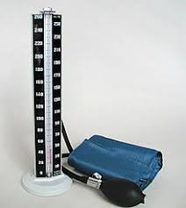
Equipment
Mercury manometer

Slide 34
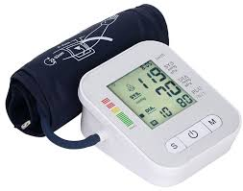
Equipment
Electronic manometer

Slide 35
Procedures before blood pressure is taken
Wipe earpieces and diaphragm with antiseptic wipes before and after each use
Warm the diaphragm of the stethoscope in your hand before touching the client/patient with it
Place the earpiece tips in your ears, bending the tips so they point forward. Earpieces should fit snugly to block out external noise
Place the diaphragm over the client/patient’s brachial artery and hold it in place
Prevent noise and ask the client/patient to remain silent while the blood pressure is being taken

Slide 36
Guidelines for Measuring Blood pressure
Do not take blood pressure on an arm with an intravenous infusion, a cast an injury or a dialysis access site
Allow the client or patient to be at rest for 10 – 20 mins before measuring blood pressure
Measure blood pressure when the client/patient is sitting or laying down unless directed otherwise by a doctor.
Use the correct sized blood pressure cuff for each client (i.e. pediatric cuff for very small arms)

Slide 37
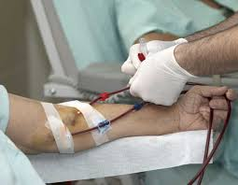
Intravenous
Dialysis access site

Slide 38
Taking Blood pressure
Apply the cuff to the bare upper arm above the elbow
Make sure the cuff is snug
Place the diaphragm of the stethoscope firmly over the artery. The entire diaphragm must be in contact with the skin
Make sure the room is quiet
Ensure that the manometer is clearly visible
Measure the systolic pressure – the first sound you hear as the cuff deflates and the diastolic pressure – the point where the sound disappears
Retake the blood pressure if you are not sure of an accurate measurement

Slide 39
Your Turn
Collect equipment
Find a partner and follow the procedures and guidelines to take your partner’s blood pressure in a sitting position
Take the blood pressure twice and record your measurements on the record sheet provided
Switch and have your partner do the same

Slide 40
Breathing Rate (Part 3)
Respiration is the act of breathing (inhalation and exhalation) by the lungs
Respirations are normally quiet, effortless, and regular

Slide 41
Breathing Rate
Shallow breathing – the chest barely moves during respiration
Deep breathing – the chest rises and falls significantly with every breath

Slide 42
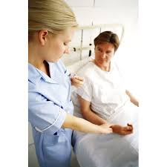
Breathing Rate
When assessing breathing rates, patients/clients tend to change their breathing rate when they know their respiration is being counted
Respirations are counted right after taking pulse by keeping your fingers at the pulse sign so the patient/client thinks you are still taking their pulse. Count how many times the chest rises and falls in 30s and multiply by 2

Slide 43
Breathing Rate
Report the following observations as well as the rate of breathing:
Uniformity and depth of respirations (shallow, normal or deep)
Respiratory rhythm – regular or irregular
Pain or difficulty breathing
Any respiratory noises

Slide 44
Normal Respiratory rates by age
Age | Respiratons per Minute
Newborn | 30-60
Infant | 25-50
Toddler | 25-32
Child | 20-30
Adolescent | 16-19
Adult | 12-20

