Slide 1
Immunity
HCS 2100
SLO: 1.0 – 1.4

Slide 2
Immunity is defined as:
The final line of defense against disease
An individual’s power to resist or overcome the effects of a particular disease agent or its harmful products
The immune system will recognize any foreign material and attempt to get rid of it

Slide 3
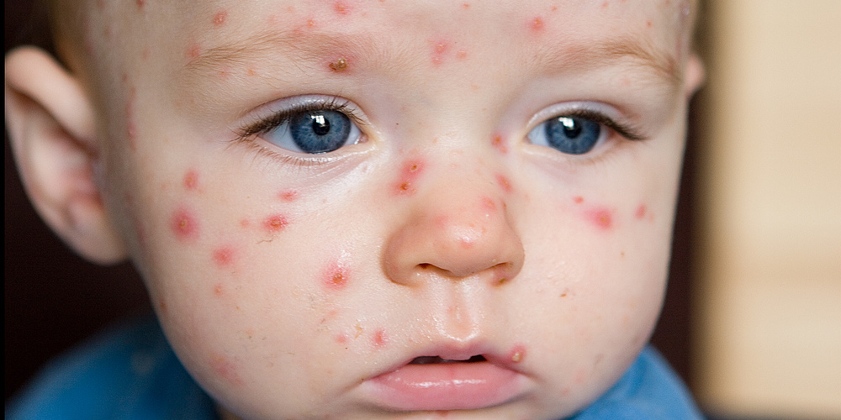
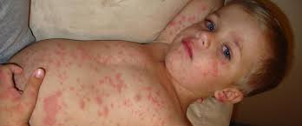
Immunity is a selective process.
Immunity to one disease does not necessarily cause immunity to another (Specificity)
Measles
Chicken pox

Slide 4
Two main categories of Immunity
Innate immunity – is inborn and is inherited along with other characteristics in a person’s genes
Acquired immunity – develops after birth. Can be natural or artificial, active or passive

Slide 5
Innate Immunity
Genetically a person may have inherited traits that allow them to be resistant to a number of diseases or conditions
This type of immunity may become obvious only after a person has been exposed to an illness.

Slide 6
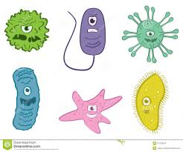
Acquired Immunity
Acquired immunity develops during a person’s lifetime as that person encounters various specific harmful agents

Slide 7
Natural Active Immunity
Each time a person is invaded by disease organisms, his or her cells manufacture antibodies that provide immunity against infection. This immunity can last for years or even for life
Because the body is actively involved in the production of antibodies, it is called active immunity
This is called natural because it is the result of the natural sequence of events when a person is exposed to a pathogen

Slide 8
Natural Passive Immunity
Acquired naturally by the passage of antibodies from a mother to her fetus through the placenta
It is called passive because the antibodies come from an outside source
This type of immunity only lasts about 6 mons at which time the infant’s own immune system begins to function
This type of immunity can be lengthened through nursing as the mother’s antibodies are present in her breast milk

Slide 9
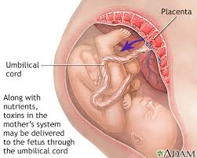
Natural Passive Immunity

Slide 10
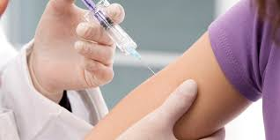
Artificial Active Immunity Vaccines
Made with live organisms that are nonvirulent to humans or with organisms killed by heat or chemicals
Stimulate an immune response to make antibodies

Slide 11
Artificial Passive Immunity Immune Serum
Used in emergencies where there no time to wait for active immunity to develop
Often derived from animals, mainly horses because horse’s tissue produce large quantities of antibodies in response to injections of the organism or their toxins
Injecting of this type of serum can cause sensitivity reactions in humans
Human antibody in the form of gamma globulin may be used to help this problem

Slide 12
Types of Antisera
RhoGAM – a concentrated human antibody given to prevent an Rh-negative mother from forming Rh antibodies after her first birth or miscarriage of an Rh positive baby
Anti-snake bite sera or antivenins – to combat the effects of certain poisonous snakes
Botulism antitoxin antiserum – from horses offers the best hope for botulism victims only if given early
Rabies antiserum – from horses or humans, used to treat bites from rabid animals

