Slide 1
Ingestion 8.3
Pg.258-263

Slide 2
Four components of the Digestive Process
1.Ingestion- the taking of nutrients
2.Digestion- the breakdown of complex organic molecules into smaller components by enzymes
3.Absorption- the transport of digested nutrients to the cells of the body
4.Egestion-the removal of food waste from the body

Slide 3
Digestive tract in adults 6.5-9m long.
2 forms of digestion; Physical and Chemical
Physical digestion (mechanical) –begins in the mouth, where food is chewed and formed into a BOLUS by the tongue. Physical digestion breaks food into smaller pieces- increasing the surface area for chemical digestion.

Slide 4
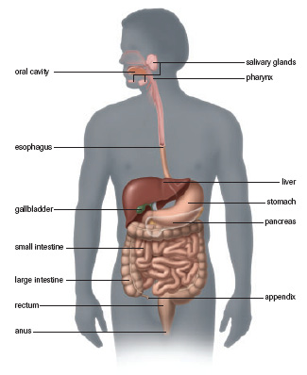

Slide 5
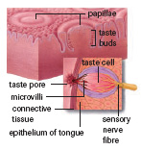
Salivary Glands
Produces watery fluid (saliva)- contains amylase enzymes which breakdown starches(complex carbs).
We detect flavor when saliva dissolve food particles penetrate your taste buds.
Different receptors respond to different flavors. Chemical compounds with specific shapes bond to receptor sites with similar shapes- this allows for the sense of different tastes.

Slide 6
Teeth
Teeth- are used for physical digestion
8- teeth in the front (incisors) used for cutting
Incisors are bordered by canines used for tearing
Premolars are next to them, used for grinding
Then there are molars which are used for crushing.
Lastly you have your wisdom teeth )hence wisdom, they do not appear until 16-20 years old).
Enamel covers the teeth which is the hardest substance in the human body.

Slide 7
Esophagus
Food travels from the mouth to the stomach via the esophagus.
The bolus stretches the walls of the esophagus which activates the surrounding muscles that set up a wave like rhythmic contraction called PERISTALSIS.
This is an involuntary movement- which moves food down the gastrointestinal tract.

Slide 8
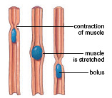
Stand on your HEAD

Slide 9
STOMACH
Food storage and initial protein digestion take place here.
There are 3 layers of muscle which allow food to be churned.
Movement of food to and from the stomach is regulated by circular muscles called SPHINCTERS.
Contraction of the lower esophageal sphincter (LES) closes the opening to the stomach, while relaxation allows food to enter. The LES helps prevent food and acid from being regurgitated into the esophagus.
The 2nd sphincter, the pyloric sphincter regulates food and acid into the small intestine.

Slide 10
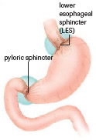
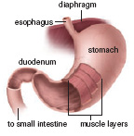

Slide 11
The stomach is J shaped and has numerous ridges to allow it to expand – can hold approx 1.5 liters of food. Millions of cells line the stomachs wall which help secrete various fluids called gastric juices/fluids which aid in digestion.
Muscle movement mix the juices and food together.

Slide 12
Therefore both chemical and mechanical digestion take place.
Approx 500ml of these fluids are secreted per 1 large meal.
Gastric juices contain mucus, hydrochloric acid(HCI), pepsinogens and other substances.
HCI kills harmful substances and converts pepsionogen into its active form of pepsin (a protein digesting enzyme). It breaks amino acid chains into shorter ones called polypeptides.

Slide 13
The pH in the stomach ranges from 2.0-3.0, but may reach 1.0.
Acids with pH of 2.0 can dissolve rugs.
A layer of alkaline mucous protects the stomach lining from being dissolved.
The esophagus does not have a mucous lining, so if the LES is weak, stomach acid may enter the esophagus and damage it.
This can cause HEART BURN

Slide 14
Peptic Ulcers
When the stomach’s lining breaks down, HCI and Pepsin are exposed to it- which leads to a PEPTIC ULCER.
Beneath the stomach’s cell walls are blood vessels. As the acid irritates the stomach lining there is an increase in blood flow and acid secretions. This causes tissue to burn and blood vessels to break down.

Slide 15
Most Ulcers are from a bacteria called Helicobacter pylori.
Initially, scientists were skeptical since it was believed that bacteria would not be able to live in such acidic environments. However, using a simple breath test it is determined that is correct.
If found early antibiotics can be used as treatment. If not treated, surgery could be required.

Slide 16
Questions Pg.263
1-7, 9, 10, 11,13

