Slide 1
Lymph Node and Spleen
HCS 2100
SLO: 2.4-2.5

Slide 2
Lymph Nodes
Designed to filter lymph once it is drained from the tissues
Sites where lymphocytes of the immune system multiply and work to combat foreign organisms.

Slide 3
Lymph Nodes
Small rounded masses along the lymph vessels
They are seldom isolated and are commonly massed together in groups varying from 2-3 to well over 100
Some are superficial (near the surface of the skin) some are deep toward the center of the body

Slide 4
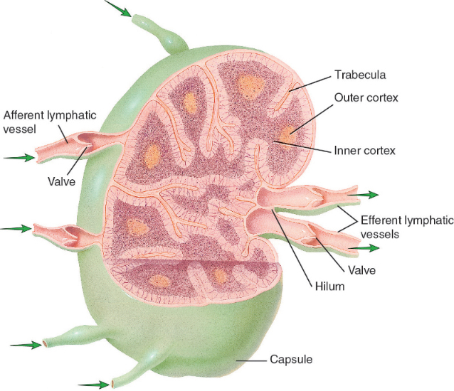
Lymph Nodes – found on pg 356 11th Edition textbook

Slide 5
To do!
Complete exercise 16-8
Label and color lymph node structures

Slide 6
Types of Lymph Nodes
Cervical nodes – located in the neck
- drain various parts of the head and neck
- often become enlarged during upper respiratory infections

Slide 7
Axillary Nodes – located in the armpits
May become enlarged after infections of the upper extremities and the breasts
Cancer cells from the breasts can spread (metastasize) to the axillary nodes

Slide 8
Tracheobronchial Nodes
Found near the trachea and around the larger bronchial tubes
People living in areas of high pollution have these nodes filled with air contaminants

Slide 9
Mesenteric Nodes
Found between the two layers of peritoneum that form the mesentery
There are approximately 110-150 of these nodes

Slide 10
Inguinal Nodes
Located in the groin area
Receive lymph drainage from the lower extremities and from the external genital organs

Slide 11
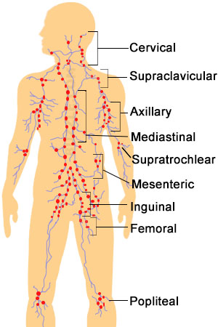

Slide 12
The Spleen
The spleen is an organ that contains lymphoid tissue designed to filter blood
It is located in the upper left region of the abdomen high up under the dome of the diaphragm and protected by the lower part of the rib cage

Slide 13
The spleen is a soft, purplish, flattened organ approximately 5 to 6 inches long
It contains involuntary muscles that enables it to contract as well as withstand some swelling
It filters the blood and also contains phagocytic white blood cells and lymphocytes that act in immunity

Slide 14
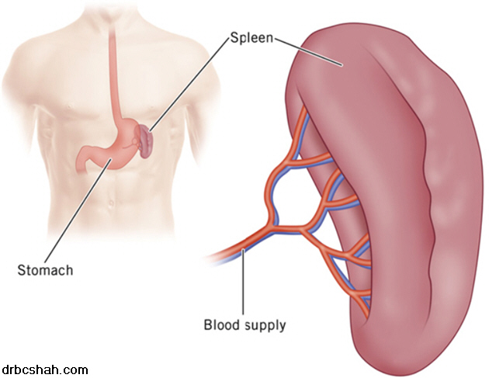
The spleen is part of the lymphatic system because it contains masses of lymphoid tissue

Slide 15
Check Point Questions and Answers
What is the function of the lymph nodes?
To filter lymph that is drained from tissue
Site where lymphocytes multiply to fight infection

Slide 16
What is filtered by the spleen?
It filters blood.
What is a splenectomy?
The surgical removal of the spleen
Why can someone live without a spleen?
Other lymphoid tissues can take over it’s function

Slide 17
Other functions of the Spleen
Cleansing the blood of impurities by phagocytosis and filtration
Destroying old, worn out red blood cells
Producing red blood cells before birth
Serving as a reservoir of blood which can be returned to the bloodstream in case of severe bleeding or other emergency

