Slide 1
Muscles
9.4
Pgs. 298 - 304

Slide 2
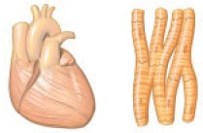
Types of Muscles
Cardiac Muscle
Muscle that makes the heart beat
Found only in the heart
Controlled by nerves of the autonomic nervous system (involuntary)

Slide 3
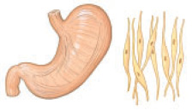
Smooth Muscles
Found in the lining of organs such as the stomach, esophagus, uterus, and walls of blood vessels
Contraction is involuntary

Slide 4
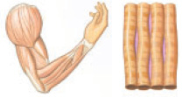
Skeletal Muscle
Muscles that are attached to the bones of the skeleton
Under conscious control (voluntary)
Attached to bones by tendons

Slide 5
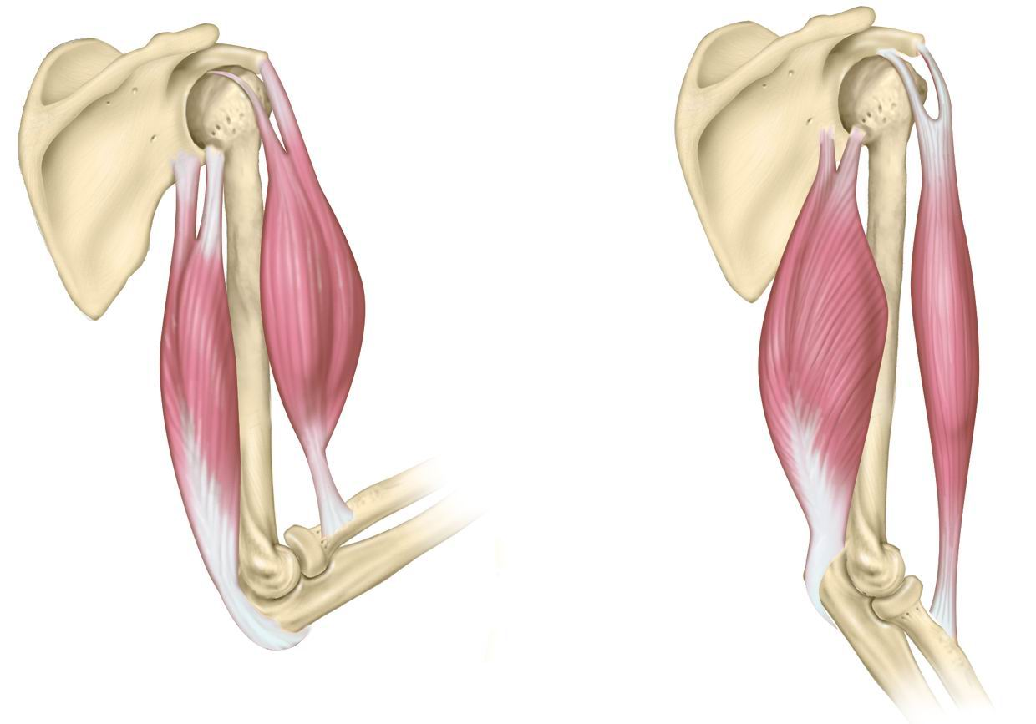
Muscles
Shorten when they contract, lengthen when they relax
Many skeletal muscles are arranged in pairs that work against each other to make a joint move – called antagonistic muscles.

Slide 6
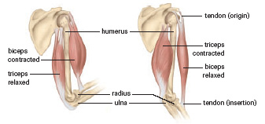
Muscles
Flexor – muscle that must contract to bend a joint
Extensor – muscle that must contract to straighten a joint

Slide 7
Central Nervous System
Ensures that the biceps and triceps do not attempt to pull against each other
Excitatory nerve impulses that cause the triceps to contract are accompanied by inhibitory nerve impulses that cause the biceps to relax.

Slide 8
Skeletal Muscles
Composed of several bundles of cells called fibres.
Muscle cells have many nuclei
Fibres are enclosed within a membrane called the sarcolemma
Within muscle fibers are tiny myofilaments (contractile proteins)

Slide 9
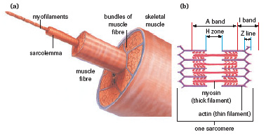

Slide 10
Two Kinds of Myofilaments
Composed of different contractile proteins
Actin – thin myofilaments
Myosin – thick myofilaments
Overlap to produce a striated (striped) appearance

Slide 11
Myofilaments

Slide 12
Sliding Filament Theory
Muscles cause movement by shortening
Actin filaments slide over myosin filaments
Z lines move closer together when muscle fibers contract
Knoblike projections on the thick myosin filaments form cross-bridges on receptor sites of the thinner actin filaments
These cross-bridges attach and detach as the actin filaments are drawn inward

Slide 13
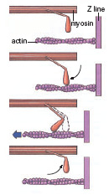
Sliding Filament Theory

Slide 14
Energy for Contraction
Energy for muscle contraction comes from ATP
In the absence of ATP – muscles become rigid
Rigor mortis – the contraction of muscles following death where skeletal muscles become fixed
Did You Know?
Rigor mortis may last for up to 60 hours after death

Slide 15
Muscle Contraction
A muscle twitch, or contraction, occurs when a nerve impulse stimulates several muscle cells
After the contraction phase, the actin and myosin filaments disengage and the muscle begins to relax.
Tetanus – the state of constant muscle contraction caused by sustained nerve impulses
Muscle spasms – are caused by involuntary contractions of muscles (often caused by a pinched nerve)

Slide 16
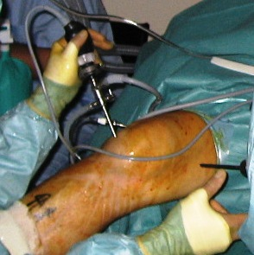
Motor Systems Injuries
Muscles require nourishment from a balanced diet and regular exercise to remain healthy
Astronauts in zero gravity show significant loss of muscle mass due to lack of muscle use and exercise
Muscle, ligament or tendon injuries can be repaired using small incisions and an arthroscope .

