Slide 1
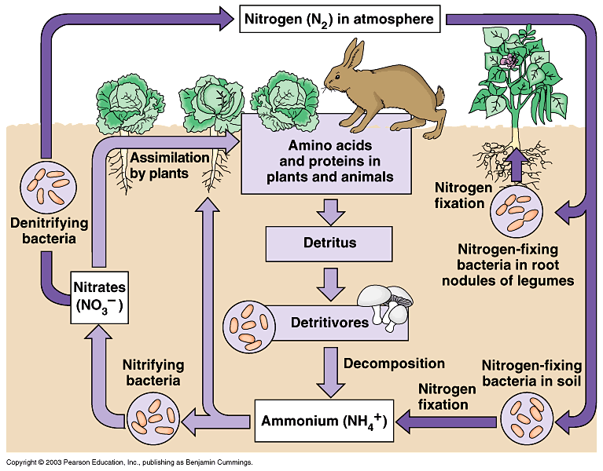
Nitrogen Cycle review

Slide 2
Nitrogen Fixation
Starts with: nitrogen gas
Processes: Lightning
Fixation with bacteria in nodules on roots of plants
Organism(s): Nitrogen fixing bacteria
Ends with: Nitrates (NO3)

Slide 3
Ammonification
Starts with: Detritus
Processes: Conversion of nitrogen in tissue by decomposition
Organism(s): Bacteria and fungi
Ends with: Ammonia (NH3) or ammonium (NH4)

Slide 4
Nitrification
Starts with: Ammonia
Processes: Converting ammonia into nitrates
Organism(s): Nitrifying bacteria in the soil (aerobic)
Ends with: Converts ammonia into nitrites (NO2) and then into nitrates (NO3)

Slide 5
Denitrification
Starts with: Detritus
Processes: Decomposition – Nitrates (NO3) into nitrogen gas(N2)
Organism(s): Denitrifying bacteria in soil (anaerobic)
Ends with: Nitrates (NO3) converted to nitrites (NO2) and finally into nitrogen gas (N2)

