Slide 1
Sensory Receptors
SLO: 1.6.2 – Classifying sensory receptors into four categories (chemoreceptors, photoreceptors, thermoreceptors and mechanoreceptors)

Slide 2
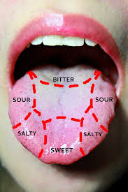
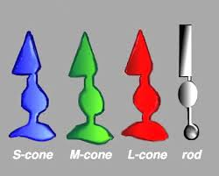
Sensory Receptors
Chemoreceptors – detect chemicals in solution (taste, smell)
Photoreceptors – detect light. Located in the retina of the eye

Slide 3
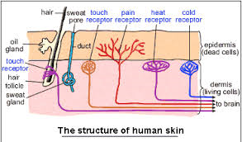
Sensory Receptors
Thermoreceptors – detect changes in temperature. Located in the skin

Slide 4
Mechanoreceptors – detect movement, stretch, pressure or vibration.
- pressure receptors in skin
- receptors that monitor body position
- receptors of hearing and equilibrium in the ear
Any receptor must receive a stimulus of adequate intensity (threshold stimulus)

Slide 5
