Slide 1
Spinal Nerves and Reflex Arc
SLO: 1.2 describe the organization of the nervous system according to structure, including:
1.2.1 naming and locating basic components of the central nervous system, including grey and white matter
1.2.2 naming and locating basic components of the peripheral nervous system, including dermatomes

Slide 2
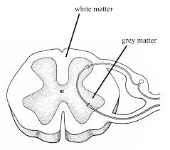
The Spinal Cord
The spinal cord has a small, irregularly shaped internal section of gray matter (unmyelinated tissue) surrounded by a larger area of white matter (myelinated axons)

Slide 3
Practice
Label and color exercise 9-15 on work book page 155 using text book pg. 201

Slide 4
Dorsal and Ventral Roots
Each nerve is attached to the spinal cord by two roots:
Dorsal root – is a marked swelling of gray matter called the dorsal root ganglion, which contains the cell bodies of the sensory neurons.
Ganglion – is any collection of nerve cell bodies located outside the CNS
Fibers from sensory receptors throughout the body lead to the dorsal roots and these dorsal ganglia.

Slide 5
Dorsal and Ventral Roots
Ventral Root – contains motor fibers that supply muscles and glands (effectors)
The cell bodies of these neurons are located in the cord’s ventral gray matter (ventral horns).
Because the dorsal (sensory) and ventral (motor) roots combine to form the spinal nerve, all spinal nerves are mixed nerves.

Slide 6
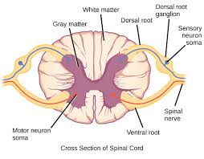

Slide 7
Dermatomes
SLO: 1.2.2 naming and locating basic components of the peripheral nervous system, including dermatomes
Sensory neurons from all over the skin, except for the skin of the face and scalp, feed information into the spinal cord through the spinal nerves.
The skin surface can be mapped into distinct regions that are supplied by a single spinal nerve

Slide 8
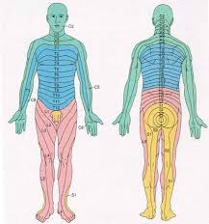
Dermatomes see text pg. 202

Slide 9
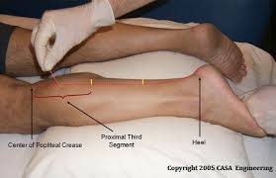
Dermatomes
Sensation from a given dermatome is carried over its corresponding spinal nerve. This information can be used to identify the spinal nerve or spinal segment that is involved in an injury.

Slide 10
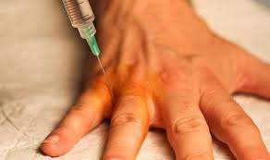
Dermatomes
Some dermatomes may share a nerve supply with neighboring regions. For this reason, it is necessary to numb several adjacent dermatomes to achieve successful anesthesia.

Slide 11
Reflex Arc
SLO: 1.7 analyze a reflex arc using personal experiences by:
1.7.1 describing the components of a reflex arc
1.7.2 describing several examples of reflexes in the body
1.7.3 demonstrating location of personal reflexes

Slide 12
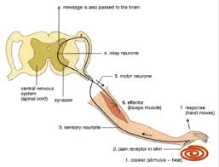
Reflex Arc
A complete pathway through the nervous system from stimulus to response is called a reflex arc.

Slide 13
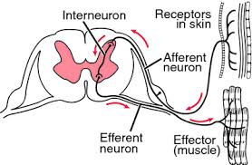
Parts of a Reflex Arc
1) Receptor – the end of a dendrite or some specialized receptor cell, as in a special sense organ, that detects a stimulus

Slide 14
Parts of a Reflex Arc
2) Sensory Neuron – a cell that transmits impulses toward the CNS. Sensory impulses enter the dorsal horn of the spinal cord’s gray matter.
3) CNS – where impulses are coordinated and a response is organized. Interneurons transmit impulses within the CNS
4) Motor Neuron – a cell that carries impulses away from the CNS. Motor impulses leave the cord through the ventral horn of the spinal cord’s gray matter.

Slide 15
Parts of a Reflex Arc
5. Effector – a muscle or a gland outside the CNS that carries out the response
Few reflex arcs involve just two neurons, one sensory and one motor, with a synapse in the CNS. The knee-jerk reflex is one of these few.

Slide 16
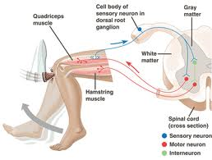
Knee-Jerk Reflex

Slide 17
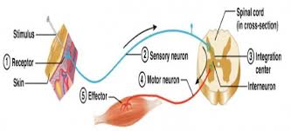
Practice
Label and color the parts of a reflex arc – Exercise 9-16 on work book page 156

Slide 18
Newborn Reflexes
https://www.youtube.com/watch?v=SOHwnFH9q18

