Slide 1
The Structures of the Human Eye
HCS 2050 – Nervous System and Senses
SLO: 1.10 – Name and locate the structures of the eye

Slide 3
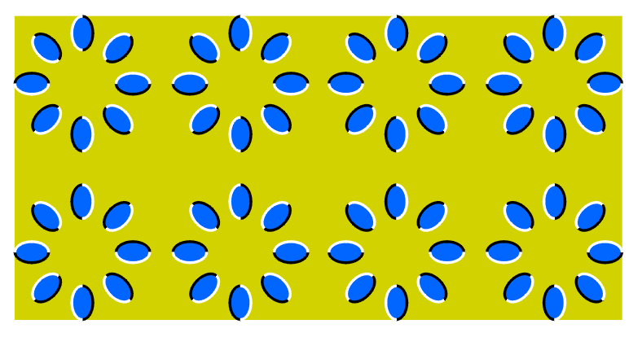

Slide 4
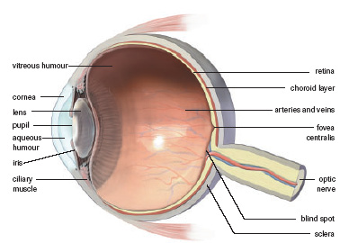

Slide 5
Practice!
Complete workbook pg. 184 Exercise 11-3
- label and color

Slide 6
Layers of The Eye
Sclera:
Outer white part of the eye → made of tough connective tissue
Resists punctures, is under fluid pressure from below
Choroid:
Middle layer → contains numerous blood vessels
Contains a black pigment → darkens the interior of the eye
Compared to the dull black lining of a camera, prevents scattering and reflecting of incoming light rays

Slide 7
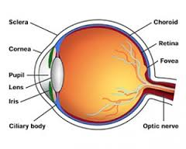
Layers of The Eye (continued)
Retina:
Contains the Photoreceptors → Rods & Cones
Converts light into nerve impulse → to the Occipital lobe

Slide 8
The Photoreceptors:
Rods
Cylinder shaped
About 120 million in each retina
Found toward the periphery of the retina
Function best in dim light
Do not provide sharp images
Pigment: rhodopsin
No color differentiation
Cones
Flask shaped
About 6 million in each retina
Concentrated at the center of the retina
Function best in bright light
Provide sharp images
Pigment: sensitive to color
Differentiates color

Slide 9
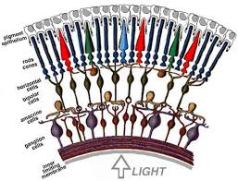
Rods and Cones

Slide 10
Are you color blind?
http://colormax.org/color-blind-test/

Slide 11
Eye Anatomy
Cornea - outer transparent skin of the eye, no blood vessels, helps to focus image (refracts light towards pupil)
Pupil- irises central opening, allows light to enter the eye

Slide 12
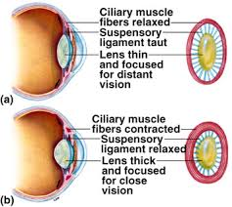
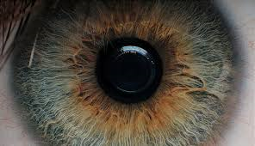
E) Eye Anatomy
Iris- circular muscle that helps control pupil size. Colored ring-like portion of the eye
Ciliary Muscles – control the shape of the lens for focusing

Slide 13
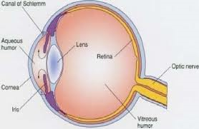
Anatomy cont’d:
Lens – focuses the image (inverts it too), made of firm, elastic material that can change thickness to focus light for near or far vision
Aqueous Humor – clear fluid found in between cornea and lens and refracts light, helps to maintain the cornea’s convex curve

Slide 14
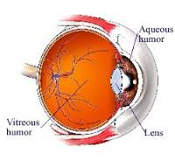
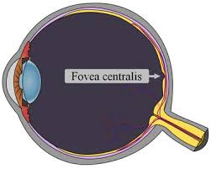
Anatomy cont’d:
Vitreous Humor – clear pressurized fluid to maintain ball shape
Fovea Centralis – 90% of cones are located here for color and sharpness of vision; most light sensitive area of the eye

Slide 15
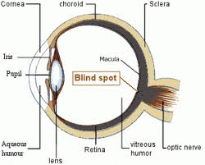
Anatomy cont’d:
Blind Spot or Optic Disc – where optic nerve leaves the eye, no photoreceptors here
Optic Nerve – contains 1 million axons to occipital lobe

Slide 16
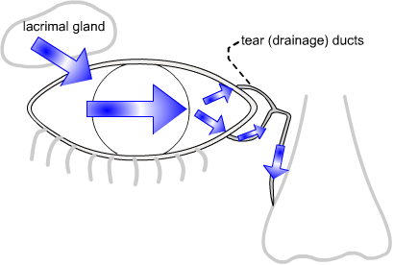
Protection of the Eye:
Bony socket
Eyebrow deflects water and debris
Eyelashes have “blink” reflexes that respond to potential danger
Lacrimal Gland (tears): (top/side of eye)
Tears flow from top/temple to bottom/nasal
Tears contain an antibiotic
Tears drain into the nose

Slide 17
Protection cont’d:
Tarsal Gland (oil): (located in the lid)
Secretes an oil to moisturize the eye
Lids sweep the eye
Sclera to resist puncture

Slide 18
Vision
Focusing: Bending Light
Light rays must be bent (refracted) to focus on the retina
Bent by: cornea, lens and to a lesser extent, humors
Accommodation Reflex – ability of lens to adjust in order to see close or distant objects.
For distant objects the lens is flat and the ciliary muscle relax
For close objects the lens becomes round and the ciliary muscles contract
With aging, lens loses some elasticity and is unable to accommodate.

Slide 19
Vision Defects:
Glaucoma: build-up of aqueous humor
Treatment: topical eye drops
Cause: high blood pressure; diabetes
Cataracts: clouding and/or hardening of lens
Treatment: removal; strong eyeglasses
Cause: age, trauma

Slide 20
Astigmatisms: irregular shaped cornea (or lens)
Treatment: glasses or contact lenses

Slide 21
Myopia: near sightedness; image is focused in front of fovea
Treatment: biconcave lens

Slide 22
Focusing Problems Animation
Hyperopia: far sightedness; image focused behind fovea
Treatment: biconvex lens

Slide 23
How the eye works:
https://www.youtube.com/watch?v=fn6v3SkH0LI

