Slide 1
The Thymus Gland and Comparing the circulatory System and the Lymphatic System
SLOs: 2.6-2.7

Slide 2
The Thymus Gland
Located above the heart and deep to the sternum
It is larger and more active earlier in life
Plays a key role in immune system development before birth and during the first few months of infancy

Slide 3
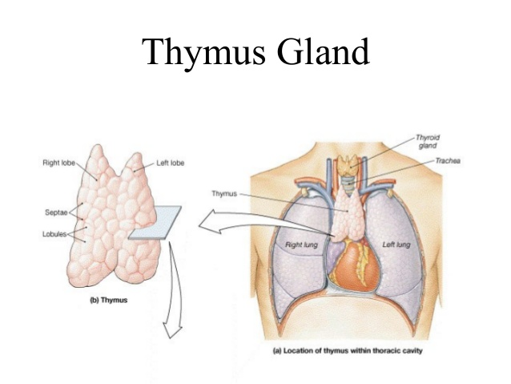
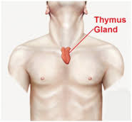
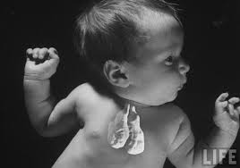

Slide 4
Certain lymphocyte (T- lymphocytes) must mature in the thymus gland before they can perform their functions in the immune system
These T cells develop under the effects of the thymus gland hormone thymosin

Slide 5
Comparisons between the Circulatory System and the Lymphatic System
Circulatory
Lymphatic
Is a one way system that begins in the tissues and ends when the lymph joins the blood
Moves lymph that drains from tissue
Relies on contractions of segments of the lymph vessels – the more fluid the faster the rate of contraction
Forms a complete circuit
Moves blood
Relies on the heart to pump blood

Slide 6
Circulatory
Lymphatic
Series of arteries and veins
Arteries carrying blood under high pressure away from the heart
Veins returning blood back to the heart with the help of skeletal muscles and valves
Vessels rely on skeletal muscle contraction and valves to keep lymph moving forward

