Slide 1
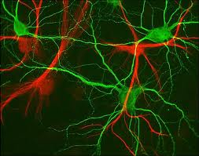
Types of Neurons
HCS 2050
SLO: 1.4 - Explain the structure and function of neurons and neuroligia
1.5 – Explain the structure and function of nerves and tracts including afferent, efferent and mixed nerves
1.6 – Summarize how a nerve impulse is transmitted

Slide 2
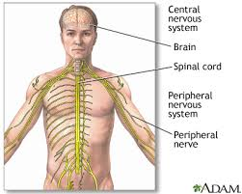
Types of Neurons
Neurons relay information to or from the CNS or within the CNS

Slide 3
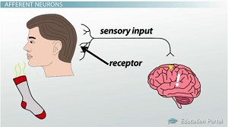
Sensory Neurons –(afferent neurons) conduct impulses to the spinal cord and brain – usually from sensory nerves (sight, sound, touch, taste and smell)

Slide 4
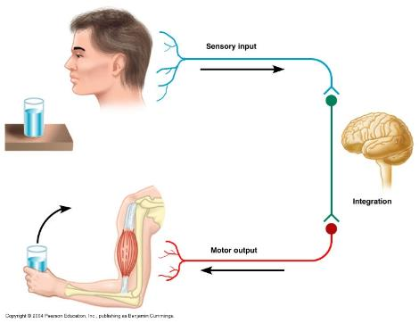
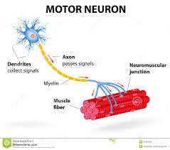
Motor Neurons – (efferent neurons) carry impulses from the CNS to muscles and glands – effectors

Slide 5
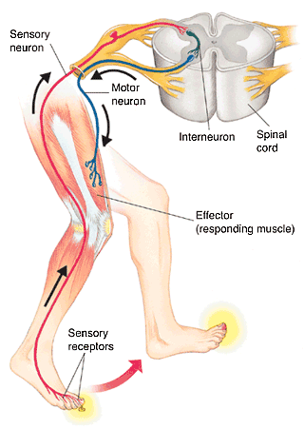
Interneurons – (central or association neurons) relay information from place to place in the CNS – learning

Slide 6
Neuron fibers are collected into bundles of different sizes
Peripheral nervous system fiber bundles are called nerves
Central nervous system fiber bundles are called tracts

Slide 7
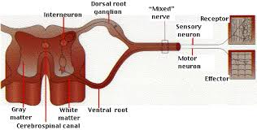
A nerve may contain all sensory fiber, all motor fibers or a combination of both (mixed nerves)

Slide 8
Most cranial and all spinal nerves carry both sensory and motor fibers called mixed nerves
Remember that in mixed nerves, impulses may be travelling in two directions (toward or away from the CNS) but each fiber can only carry an impulse in one direction
Like a divided highway

Slide 9
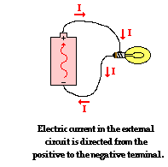
Nerve Impulse
A nerve impulse can be compared to the spread of an electric current along a wire

Slide 10
Resting State
At rest (not stimulated), a neuron’s membrane has a negative charge inside the cell and a positive charge on the outside – polarized. The separation of these charges allows for the possibility (potential) for generating electricity if the charges move toward each other.

Slide 11
Watch video clip – Neuron Activity

Slide 12
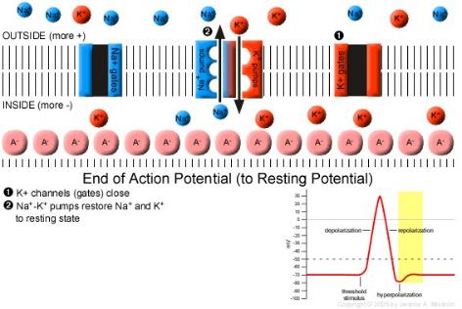
Inside the cell is a higher concentration of potassium ions
Outside the cell is a higher concentration of sodium ions

Slide 13
Depolarization
A stimulus (electrical, chemical or mechanical of adequate force) causes specific channels in the membrane to open and allow Na+ to flow into the cell. As they move into the cell they make the inside of the membrane less negative, causing an electrical difference - depolarization

Slide 14
Repolarization
The K+ channels open to allow K+ to leave the cell. As the electric charge returns to resting value, the membrane undergoes repolarization. While the membrane is repolarizing, it does not respond to further stimulation. This means the action potential spreads in only one direction.

Slide 15
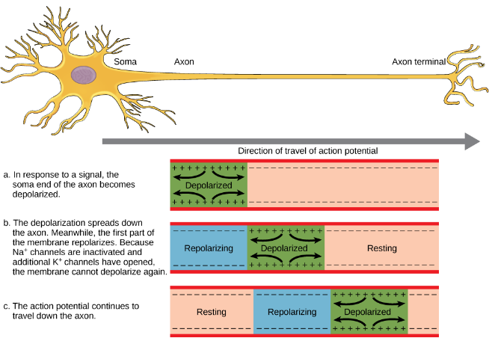
Action Potential

Slide 16
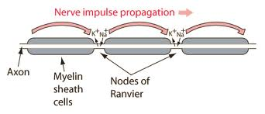
Myelin Conduction
Some axons are covered (coated) with fatty material called myelin
If a fiber is not myelinated, the action potential spreads continuously along the cell’s membrane

Slide 17
Saltatory Conduction
When an axon is myelinated, the myelin causes the action potential to “jump” like a spark from node to node.
This type of conduction is called saltatory conduction (This type of conduction is impaired with MS)

